Slide 1
Web Technology JavaScript Programming Chapter 1 :What is JavaScript? Chapter 2: JavaScript in HTML
University of Computer Studies
Department of Information Technology Supporting and Maintenance

Slide 2
General Lecture Plan
Section 1
What is JavaScript?
JavaScript in HTML
Variables, Scope, and Memory
Section 2
Language Basics
Reference Types
Function
Section 3
Understanding Objects
Window Object
Section 4
Document Object Model (DOM) and DOM Extensions
Section 5
Events, Forms and Canvas
Section 6
Client-side Storage

Slide 3
What is JavaScript? / JavaScript’s History
What is JavaScript?
JavaScript is a scripting language designed to interact with web pages
JavaScript purpose was to handle some of the input validation
JavaScript has grown into an important feature of every major web browser on the market.
JavaScript is recognized as a full programming language
JavaScript is very loosely based on Java
JavaScript (js) is a light-weight object-oriented programming language which is used by several websites for scripting the webpages.
It enables dynamic interactivity on websites when applied to an HTML document.
JavaScript’s History
JavaScript was created in 10 days by Brendan Eich
JavaScript original name is Mocha
Java was famous at that time, hence the name “JavaScript” was changed to ride on Java’s success
JavaScript has nothing to do with Java
Microsoft created a reverse engineered version of JavaScript, known as Jscript

Slide 4
JavaScript Implementation / Versions/ Editors
JavaScript Implementation
Component
ECMAScript,
Document Object Model (DOM),
Browser Object Model (BOM).
Browser
IE6, Firefox, Chrome, Opera, Safari, and Microsoft Edge
Operating System
Windows, Mac, or Linux
JavaScript Editors
Sublime Text
Visual Studio Code
Brackets
Atom
Komodo Edit
Notepad++
BBEdit
Text Mate
Emacs
Vim
JavaScript Versions
The Original JavaScript ES1 ES2 ES3 (1997-1999)
The First Main Revision ES5 (2009)
The Second Revision ES6 (2015)
The Yearly Additions (2016, 2017, 2018, 2019, 2020, 2021,2022-ES13)

Slide 5
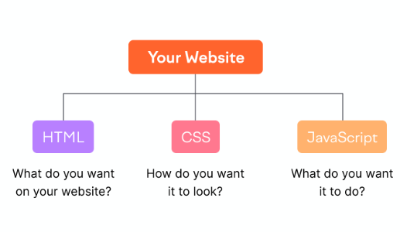
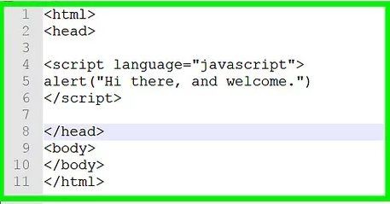
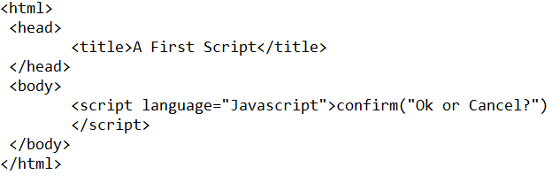
Way of using JavaScript
Most <script> elements were placed within the <head> element on a page
The most preferred ways to include JavaScript in an HTML page are as follows
Script in <head>…</head> section
Script in <body>…</body> section
Script in <body>…</body> and <head>…</head> sections
Script in an external file and then include in <head>…</head> section

Slide 6
Internal, External, Inline
Internal JavaScript : JavaScript code is placed in the head and body section of an HTML page.
Eg:
<!DOCTYPE html>
<html>
<head>
<title>Internal JavaScript</title>
<script type="text/javascript">
document.write("This is Internal
Javascript Example.!!!");
</script></head>
<body></body>
</html>
External JavaScript : JavaScript code are stored in separate external file using the .js extension. (Best Practice : maintainability, caching, future-proof)
Eg:
<!DOCTYPE html>
<html>
<head>
<title>External JavaScript</title>
<script type="text/javascript"
src="external.js">
</script></head>
<body></body>
</html>
external.js
document.write(“This is External JavaScript Example!!!”);
Inline JavaScript : When JavaScript was written within the html element using attributes related to events of the element then it is called as inline JavaScript.
Eg:
<!DOCTYPE html>
<html>
<head>
<title>Use inline javascript</title>
<script type="text/javascript">
function Inlinetest() {
alert('This function was defined inline');
}
</script></head>
<body onLoad='Inlinetest()'></body>
</html>

Slide 7
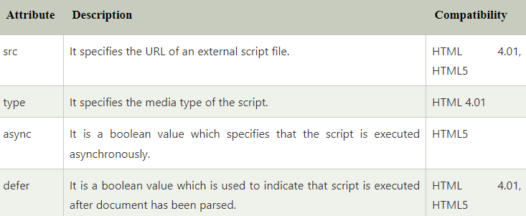
The <Script> Element
The primary method of inserting JavaScript into an HTML page is via the <script> element
There are six attributes for the <script> element
type
src
language (to mention the scripting language)
<script language= “javascript” type=“text/javascript”>
async
charset
defer

Slide 8
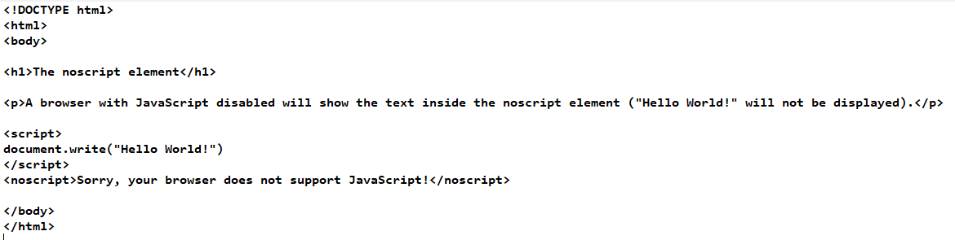
The <noscript> Element
Any content contained in a <noscript> element will be displayed under only the following two circumstances:
The browser doesn’t support scripting
The browser’s scripting support is turned off

Slide 9
JavaScript Output
JavaScript can display data in different ways
Writing into HTML element, using inner HTML.
Writing into HTML output, using document.write( ).
(Eg: document.write.html)
Writing into an alert box, using window.alert( ).
Writing into the browser console, using console.log( ).

Slide 10
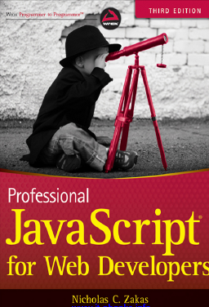
Reference Book
Professional JavaScript for Web Developers , Third Edition By Nicholas C. Zakas
www.w3schools.com
www.javapoint.com

Slide 11
Web Technology JavaScript Programming Chapter 3: Language Basics
University of Computer Studies
Department of Information Technology Supporting and Maintenance

Slide 12
Outlines
Basic JavaScript Syntax
Data types
Operators
Statements
Functions

Slide 13
Identifiers
An identifier is the name of a variable, function, property, or function argument.
eg. x, y, n1, num2, $total, _result
Identifiers may be one or more characters in the following format:
- The first character must be a letter, an underscore (_), or a dollar sign ($).
- All other characters may be letters, underscores, dollar signs, or numbers.
ECMAScript identifiers use camel case, meaning that the first letter is lowercase and each additional word is offset by a capital letter, like this:
eg. doSomethingImportant, myCar, firstSecond
Keywords, reserved words, true, false, and null cannot be used as identifiers
In JavaScript , variables, function names, and operators are all case-sensitive
eg. a variable named test is different from a variable named Test

Slide 14
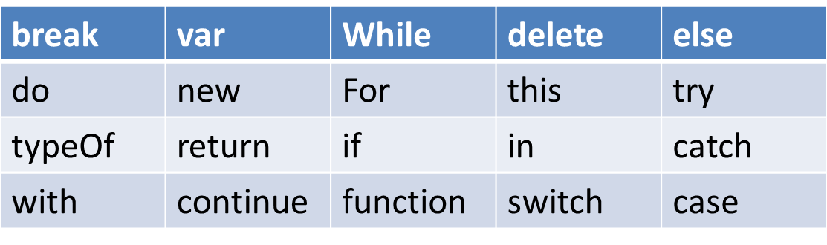
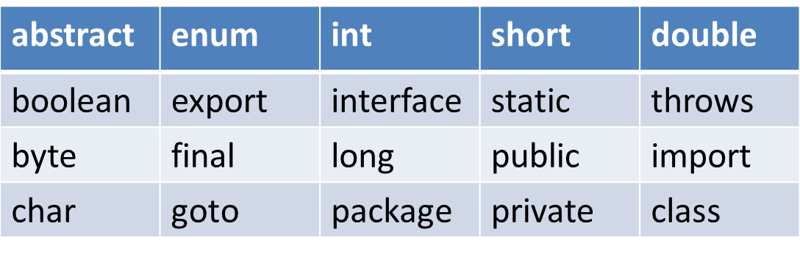
Keyword And Reserved Words
Some of keywords:
Some of reserved words (a word that cannot be used as an identifier):

Slide 15
Statements
Statements in ECMAScript are terminated by a semicolon, as in the following examples:
var num = 100 ;
alert(num);
Multiple statements can be combined into a code block with left curly brace ({) and ending with a right curly brace (}):
if (test){
test = false;
alert(test);
}

Slide 16
Comments
JavaScript comments can be used to explain JavaScript code.
JavaScript comments can also be used to prevent execution, when testing alternative code.
- single Line Comment
//
Eg: //document.write(“Hi”);
- A block comment/a multi-line comment
/* */
Eg: /* var name=“Hla”;
document.write(“Hello” + name); */

Slide 17
Variables
To define a variable, use the var keyword followed by the variable name,
Syntax: var variablename;
Variables can hold different data types: numbers, strings, objects, boolean, undefined and Null
eg: var name=“hla”; // string type
var num=100; // Number type
var found=true; // Boolean type
var name; // undefined type
eg: function test() {
var message = “hi”; // local variable }
test();
alert(message);//error(variable is destroyed when the function exits)
eg: function test() {
message = “hi”; //global variable }
test();
alert(message);//”hi”

Slide 18
Data Type
There are five simple data types (primitive types) in ECMAScript: Undefined; Boolean, Number, String, Null.
There is one complex data type called Object (an unordered list of name-value pairs).
To determine the data type of a given variable : the typeof operator needs to be used.
The typeof operator provides that information.
eg. var name=“hla”;
alert(typeOf name); //string
alert(typeOf 95); //number

Slide 19
The Nature of Strings
Zero or more characters written inside quotes, use single or double quotes:
eg. var lastName=“ ”;
eg. var lang = “Java”;
lang = lang + “Script”; // “JavaScript”
Converting to a string
ToString() // no argument
string()
eg. var age = 11;
var ageAsString = age.toString(); //the string “11”
eg. var value1 = 10;
var Strr = String(value1); //”10”
Length property
eg. var st=“computer studies”;
alert(st.Length); //16

Slide 20
Character Literals
The backslash (\) escape character
\n New Line
\t Tab
\b backspace
\\ Backslash (\)
\’ Single quote( ’ ) eg. text= 'It\'s alright.';
\’’ inserts a double quote in a string: ( ’’ )

Slide 21
The Null Type
The Null type has only one value: the special value null, a null value is an empty object pointer,
example:
var car = null;
alert(typeof car); //”object”
undefined and null are equal in value but different in type:
typeOf undefined // undefined typeOf null // object null === undefined // false null == undefined // true

Slide 22
The Number Type
Numbers can be written with, or without decimals:
var num=55; //integer
var Num1 = 1.1; //float
var Num2 = 0.1; //float
For very large or very small numbers, using scientific (exponential)notation.
var floatNum = 3.125e7; //equal to 31250000
“Take 3.125 and multiply it by 10⁷ .”
NaN = means Not a number
-is a special number value
eg. dividing a number by 0 returns NaN.

Slide 23
Number Conversions
Three functions to convert non numeric value into number:
Number()
ParseInt()
Parsefloat()
1. Number()
Converting to numbers from various data types can get complicated,
var num1 = Number(“Hello world!”); //NaN
var num2 = Number(“ ”); //0 If empty string, it is converted to 0
var num3 = Number(“000011”); //11(leading zeros are ignored)
var num4 = Number(true); //1

Slide 24
Number Conversions (Cont’d)
ParseInt()
var num1 = parseInt(“1234blue”); //1234
var num2 = parseInt(“”); //NaN
var num3 = parseInt(“0xA”); //10 - hexadecimal
var num4 = parseInt(22.5); //22
var num5 = parseInt(“70”); //70 - decimal
All of the different numeric formats can be confusing to keep track of, so parseInt() provides a second argument: the radix (number of digits) to use.
var num1 = parseInt(” 0xAF”, 16); //175
var num2 = parseInt(”AF”); //NaN

Slide 25
Number Conversions (Cont’d)
Parsefloat()
var num1 = parseFloat(“1234blue”); //1234 – integer
var num2 = parseFloat(“0xA”); //0
var num3 = parseFloat(“22.5”); //22.5
var num4 = parseFloat(“22.34.5”); //22.34
var num5 = parseFloat(“0908.5”); //908.5
var num6 = parseFloat(“3.125e⁷”); //31250000

Slide 26
Booleans, Operators
Booleans can only have two values: true or false. Booleans are often used in conditional testing.
var x = 5; var y = 6; (x < y) // Returns true (x == y) // Returns false
Unary Operators
- Increment/decrement
- Unary Plus and Minus
Boolean Operator
-there are three Boolean operators: NOT, AND, OR

Slide 27
Unary Operator
Operators that work on only one value (increment/decrement) a prefix increment, which adds 1 to a number:
eg. var age = 29;
++age; (or) age = age + 1; //30
prefix decrement, subtracting 1 from a number :
eg. var age = 29;
--age; (or) age = age -1; //28
Postfix increment and decrement differ from the prefix versions: the increment or decrement doesn’t occur until after the containing statement has been evaluated.
eg. var age = 29;
alert(age++); //29
alert(age); //30

Slide 28
Unary Plus and Minus
The unary plus and minus operators are familiar symbols and operate the same way in ECMAScript as they do in high-school math.
eg: var num = 25; num = +num; //still 25/ + 25
var num = 25; num = -num; //becomes -25

Slide 29
Multiplicative Operators, Additive Operators
Multiplicative Operators are multiply, divide and modulus.
Multiply operator (*)
eg. var result = 3 * 5; //result 15
Divide operator (/)
eg. var result = 66 / 11; //result 6
Modulus operator (%)
eg. var result = 26 % 5; //result 1
Additive Operators : add and subtract
Add(+)
eg. var result = 1 + 2; //3
Subtract(-)
eg. var result = 2 - 1; //1

Slide 30
Relational Operators, Equality Operators
Each of these operators returns a Boolean value.
less-than (<), greater-than (>)
eg: var result1 = 5 > 3; //true
var result2 = 5 < 3; //false
eg:. if (i > 25)
for (var i=1; i < 10; i++)
eg: var result = “23” < “3”; //true
var result= “23” < 3 ; //false
less-than-or-equal-to (<=)
eg. if (i <= 25)
greater-than-or-equal-to (>=)
eg. if (i >= 25)
Equality Operators : =, !=
eg. if(a==25)/ if (a !=25)

Slide 31
Equal Operator
Identically Equal Operator
is represented by three equal signs (===) as in this example:
if(“55” === 55) // false - because a string is not equal a number without conversion
if(“55” == 55) // true - equal because of conversion (the string “55” is converted to the number 55)
null == undefined // true because they are same value
null === undefined // false because they are not same type
Not Identically Equal Operator
is represented by an exclamation point followed by two equal signs (!==) and returns true only if the operands are not equal without conversion, as in this example:
if(“55” !== 55) //true - they are not equal because different data type
if(“55” != 55) //false - equal because of conversion

Slide 32
Conditional Operator
This basically allows a conditional assignment to a variable depending on the evaluation of the boolean expression.
Syntax:
variable =boolean expression ? true value : false value;
If it’s true, then true_value is assigned to the variable; if it’s false, then false_value is assigned to the variable
Eg. var max = (num1 > num2) ? num1 : num2;
In this example, max is to be assigned the number with the highest value. The expression states that if num1 is greater than num2, then num1 is assigned to max. If, however, the expression is false, then num2 is assigned to max.

Slide 33
Assignment Operators and Compound Assignment Operators
Assignment Operators
- the equal sign (=) and simply assigns the value on the right to the variable on the left
Eg. var num = 10 ;
Compound Assignment Operators
- one of the multiplicative, additive, followed by an equal sign (=)
Multiply/assign (*=)
Divide/assign (/=)
Modulus/assign (%=)
Add/assign (+=)
Subtract/assign (-=)
Eg. var num = 7;
num += 4; //11

Slide 34
Statements
1.If
2.Do while
3.While
4.For
5.For in
6.Break and continue
7.With
8.switch

Slide 35
If statements
if (condition) {
// block of code to be executed if the condition is true } else { // block of code to be executed if the condition is false }
eg1. if (i > 25) {
alert(“Greater than 25.”);}
else {
alert(“Less than or equal to 25.”); }
eg2. if (i > 25)
alert(“Greater than 25.”); //one-line statement

Slide 36
If……..else if………else
If……..else if………else
Syntax:
if (condition1) statement1
else if (condition2) statement2
else statement3
if (i > 25) {
alert(“Greater than 25.”);
} else if (i < 0) {
alert(“Less than 0.”);
} else {
alert(“Between 0 and 25, inclusive.”); }

Slide 37
The while Statement , The do-while Statement
While statement is a pretest loop. Loops can execute a block of code as long as a specified condition is true.
while (condition) { // code block to be executed }
Eg. var i = 0;
while (i < 10) {
i += 2;
}
This loop will execute the code block once, before checking if the condition is true, then it will repeat the loop as long as the condition is true.
do { // code block to be executed } while (condition);
Eg. var i = 0;
do {
i += 2;
} while (i < 10); //2, 4, 6, 8, 10

Slide 38
for Statement
Syntax:
for (initialization; expression; post-loop-expression) statement ;
Example
var count = 10;
for (var i=0; i < count; i++)
alert(i);
This for loop is the same as the following:
var count = 10, i = 0;
while (i < count){
alert(i);
i++; }

Slide 39
for-in Statement
The JavaScript for-in statement loops through the properties of an Object.
Syntax:
for (property in expression) statement
Example:
for (var propName in window) { document.write(propName); }

Slide 40
The break and continue Statements
This is stricter control over the execution of code in a loop. The break statement exits the loop immediately. The continue statement exits the loop immediately, but execution continues from the top of the loop.
var num = 0;
for (var i=1; i < 10; i++) {
if (i % 5 == 0) {
break;
} num++;
} alert(num); //4

Slide 41
The break and continue Statements (Cont’d)
var num = 0;
for (var i=1; i < 10; i++) {
if (i % 5 == 0) {
continue;
} num++;
} alert(num); //8
the alert displays 8, the number of times the loop has been executed.
When i reaches a value of 5, the loop is exited before num is incremented, but execution continues with the next iteration, when the value is 6.
The loop then continues until its natural completion, when i is 10.
The final value of num is 8 instead of 9, because one increment didn’t occur because of the continue statement

Slide 42
switch Statement
Closely related to the if statement is the switch statement, as you can see here:
switch (expression) {
case value: statement
break;
case value: statement
break;
case value: statement
break; default: statement }
Each case in a switch statement says, “If the expression is equal to the value, execute the statement.”
The break keyword causes code execution to jump out of the switch statement.
Without the break keyword, code execution falls through the original case into the following one.
The default keyword indicates what is to be done if the expression does not evaluate to one of the cases. (In effect, it is an else statement.)

Slide 43
switch Statement
Example:
switch (i) {
case 25:
alert(“25”);
break;
case 35:
alert(“35”);
break;
case 45:
alert(“45”);
break;
default:
alert(“Other”);
}

Slide 44
Functions
Functions in ECMAScript are declared using the function keyword, followed by a set of arguments and then the body of the function.
Syntax :
function functionName(arg0, arg1,...,argN) { statements }
Example:
function sayHi(name, message) {
alert(“Hello “ + name + “, “ + message); }

Slide 45
Functions (Cont’d)
Function
(i)not return
Eg: function sayHi(name, age)
{
alert(“Hello!” +name +” “+ age); //Hello! Hnine Hnine 20
}
sayHi(“Hnine Hnine”, 20);
(ii) return
Eg: function sum(num1,num2) {
return( num1 + num2);
} // defined function block
var result=sum(10,20); //call function
alert(result); //30

Slide 46
Functions (Cont’d)
Eg:
function sum(num1, num2) {
return num1 + num2;
alert(“Hello world”); //never executed
}
In this Example, the alert will never be displayed because it appears after the return statement ; exits from defined function

Slide 47
Number of Arguments
determine how many arguments were passed in by using the length property, arguments.Length
Eg:
function howManyArgs(){ alert(arguments.Length);
}
howManyArgs(“Hi”, mtla); //2
howManyArgs(); //0
howManyArgs(12); //1

Slide 48
Number of Arguments (Cont’d)
It’s also possible to have more than one return statement in a function, like this:
function diff(num1, num2) {
if (num1 > num2) {
return num1 - num2;
} else {
return num2 - num1;
}
}
access each argument using bracket notation (the first argument is arguments[0], the second is arguments[1], and so on)
function doAdd() {
if(arguments.length == 1) {
alert(arguments[0] + 10);
} else if (arguments.length == 2) { alert(arguments[0] + arguments[1]);
} }
doAdd(10); //20
doAdd(30, 20); //50

Slide 49
No Overloading
function addSomeNumber(num){
return num + 100; }
function addSomeNumber(num) {
return num + 200; }
var result = addSomeNumber(100); //300
the function addSomeNumber() is defined twice.
The first version of the function adds 100 to the argument, and the second adds 200.
When the last line is called, it returns 300 because the second function has overwritten the first.

Slide 50
Web Technology JavaScript Programming Chapter 4 :Variables, Scope and Memory
University of Computer Studies
Department of Information Technology Supporting and Maintenance

Slide 51
Outline
Working with primitive and reference values in variables
Understanding execution context
Understanding garbage collection

Slide 52
Primitive and Reference values
Statically Typed Programming : a programming language characteristic in which variable types are explicitly declared and thus are determined at compile time.
Dynamically Typed Programming : a compiler or an interpreter assigns a type to all the variables
at run-time. The type of a variable is decided based on its value.
Copying value
Eg (1) String x=“Mg Mg”; //String
int num=”20”; //integer
Eg (2) var name=“Mg Mg”; //String
var num=“20”; //number
Eg (3) var obj1=new Object();
var obj2=obj1;
obj1.name=“Mg Mg”;
alert(obj2.name); //”Mg Mg”

Slide 53
Primitive and Reference values (Cont’d)
Primitive and reference values are defined similarly (a variable is created and assigned a value) but quite different.
With reference value, properties and methods can add, change, or delete at any time.
A primitive (primitive value, primitive data type) is data that is not an object and has no methods or properties.
Primitives can't be modified once a value is assigned.
var person=new object();
person.name=Mg Mg;
alert(person.name); //Mg Mg
var name=Mg Mg;
name.age=27;
alert(name.age); //undefined
(a property called age is defined on the string name and assigned a value of 27. On the very next line, the property is gone. Only reference values can have properties defined dynamically for later use.)

Slide 54
Argument Passing
When an argument is passed by value, the value is copied into a local variable.
When an argument is passed by reference, the location of the value in memory is stored into a local variable
function addTen (num){
num+=10;
return num;
}
var count=20;
var result=addTen(count);
alert(count); //20 – no change
alert(result); //30

Slide 55
Execution Context and Scope
var color=“blue”;
function changeColor(){
var anotherColor=“red”;
function swapColors(){
var tempColor=anotherColor;
anotherColor=color;
color=tempColor; //red
//color, anotherColor, tempColor are all accessible here
}
//color, anotherColor are accessible here, but not tempColor
swapColors();
}
//only color is accessible here
changeColor();
var color=“blue”; //global scope
function changeColor(){
//changeColor function scope
if (color===“blue”){
color=“red”;
}else{
color=“blue”;
}
}
changeColor();

Slide 56
Variable Declaration
Local variable
function add(num1,num2){
var sum=num1+num2;
return sum;
}
var result=add(10,20);//30
alert(sum);//error
Global variable
function add(num1,num2){
sum=num1+num2;
return sum;
}
var result=add(10,20);//30
alert(sum);//30

Slide 57
Garbage collection
JavaScript is a garbage-collection language, meaning that the execution environment is responsible for managing the memory required during code execution.
The predominant garbage-collection algorithm is called mark-and-sweep.
A second, less-popular type of garbage collection is reference counting.
In a garbage-collected programming environment, developers typically don’t have to worry about memory management.

Slide 58
Web Technology JavaScript programming Chapter 5 : References Type
University of Computer Studies
Department of Information Technology Supporting and Maintenance

Slide 59
The Object Type
Creating Object with "new“ keyword, which is created as object:
var person = new object();
person.name = “Nichloas”;
person.age = 29;
(or)
JavaScript objects are written with curly braces {}.
Object properties are written as name:value pairs, separated by commas. Create a JavaScript object with an object literal:
var person = { name:”Nicholas”, age:29};
(or)
var person = {};
person.name = “Nichloas”;
person.age = 29;
alert(person[“name”]); // Nichloas
alert(person.name); // Nichloas
alert(person.age); //29

Slide 60
Creating and manipulating arrays
Arrays can be created in two basic ways
Array constructor (using new keyword)
Array literal
The syntax of creating array using array constructor is given below:
var colors=new Array();
(or)
var colors=new Array(20);// creates an array with an initial length value of 20
(or)
//create an array with three items, the string “red”, “blue”, “green”
var colors=new Array(“red”, “blue”, “green”);
The syntax of creating array using array literal is given below:
//creates an array with three strings var colors=[“red”, “blue” , “green”];

Slide 61
Creating and manipulating arrays (Cont’d)
(or)
var colors=[]; //creates an empty array
colors[0]=“red”;
colors[1]=“blue”;
colors[2]=“green”;
Manipulating arrays
var colors=[“red”, “blue”, “green”]; //define an array of strings
alert(colors[0]); //display the first item
colors[2]=“black”; //change the third item
colors[3]=“brown”; //add a fourth item
The number of items in an array is stored in the length property, which always return 0 or more
var colors=[“red”, “blue”, “green”]; //creates an array with three strings
var names=[]; //creates an empty string
alert(colors.length); //3
alert(names.length); //0

Slide 62
Creating and manipulating arrays (Cont’d)
Length property in not read-only. By setting the length property , you can easily remove items from or add items to the end of the array.
var colors=[“red”, “blue” , “green”];
colors.length=2;
alert(colors[2]); //undefined
var colors=[“red”, “blue” , “green”];
colors.length=4;
alert(colors[3]); //undefined
Length property can also be helpful in adding items to the end of an array
var colors=[“red”, “blue” , “green”]; //creates an array with three strings
colors[colors.length]=“black”; //add a color (position 3)
colors[colors.length]=“brown”; //add another color (position 4)

Slide 63
Conversion Methods
All objects have toLocaleString(), toString(), and valueOf() methods.
The toString() and valueOf() methods return the same value when called on an array.
The result is a comma-separated string that contains the string equivalents of each value in the array, which is to say that each item has its toString() method called to create the final string.
Eg:
var colors = [“red”, “blue”, “green”]; //creates an array with three strings
alert(colors.toString()); //red,blue,green
alert(colors.valueOf()); //red,blue,green
alert(colors); //red,blue,green

Slide 64
join() Method
The join() method accepts one argument, which is the string separator to use, and returns a string containing all items.
var colors=[“red”, “green”, “blue”];
alert(colors.join(“,”)); //red, green, blue
alert(colors.join(“||”)); //red||green||blue

Slide 65
Stack Methods
The push() method accepts any number of arguments and adds them to the end of the array, returning the array’s new length.
The pop() method, removes the last item in the array, decrements the array’s length, and returns that item.
var colors= new Array(); //create an array
var count=colors.push(“red”, “green”); //push two items
alert(count); // 2
var count=colors.push(“black”); //push another item on
alert(count); // 3
var item=colors.pop(); //get the last item
alert(item); //”black”
alert(colors.length); //2

Slide 66
Queue Methods
The shift() method which removes the first item in the array and returns it and then decrementing the length of the array by one.
var colors=new Array();
var count=colors.push(“red”, “green”)
alert(count); //2
count=colors.push(“black”);
alert(count); //3
var item=colors.shift();
alert(item); //red
alert(colors.length); //2

Slide 67
Queue Methods (Cont’d)
The unshift() method which adds any number of items to the front of an array and returns the new array length.
var colors=new Array(); //create an array
var count=colors.unshift(“red”, “green”);//push two items
alert(count);//2
count=colors.unshift(“black”); //push another item on
alert(count);//3

Slide 68
Reordering Methods
Two methods deal directly with the reordering of items already in the array: reverse() and sort().
The reverse() method simply reverses the order of items in an array.
The sort() method puts the items in ascending order — with the smallest value first and the largest value last. To do this, the sort() method calls the String() casting function on every item and then compares the strings to determine the correct order.
Eg:
var values = [1, 2, 3, 4, 5];
values.reverse();
alert(values); //5,4,3,2,1
var values = [0, 1, 5, 10, 15];
values.sort();
alert(values); //0,1,10,15,5

Slide 69
Manipulating Methods
When no arguments are passed in ,concat() simply clones the array and returns it.
If one or more arrays are passed in, concat() appends each item in these arrays to the end of the result.
If the values are not arrays, they simply appended to the end of the resulting array.
var colors=[“red”, “green”, “blue”];
var colors2=colors.concat(“yellow”, [“black”, “brown”];
alert(colors); //red,green,blue
alert(colors2); //red,green,blue,yellow,black,brown

Slide 70
slice() Method
The slice() method , creates an array that contains one or more items already contained in an array and then may accept one or two arguments: the starting and stopping positions of the items to return.
If only one argument is present, the method returns all items between that position and the end of the array.
If there are two arguments, the method returns all items between the start position and the end position, not including the item in the end position.
var colors=[“red”, “green”, “blue”, “yellow”, “purple”];
var colors2=colors.slice(1);
var colors3=colors.slice(1,4);
alert(colors2); //green,blue,yellow,purple
alert(colors3); //green,blue,yellow

Slide 71
Web Technology JavaScript programming Chapter 5-2 : The Array Type, RegExp Type
University of Computer Studies
Department of Information Technology Supporting and Maintenance

Slide 72
Splice( ) method
To change the contents of an array by removing or replacing existing elements and/or adding new elements in place
Main purpose : to insert items into the middle of an array
There are three distinct ways of using this method.
Deletion — Any number of items can be deleted from the array by specifying just two arguments
splice( position of first item to delete , number of items to delete )
splice( 0 , 2 ) //deletes the first two items
eg: var colors=[“red”, “green”, “blue”];
var removed=colors.splice(0,1); //remove the first item
alert(colors); //green,blue
alert(removed);//red – one item array
Insertion — Items can be inserted into a specific position by providing three or more arguments
splice( starting position, number of items to delete, item to insert )
splice( 2 , 0 , “red”, “green” )
// insert the strings “red” and “green” into the array at position

Slide 73
Con’t
eg: removed=colors.splice(1,0, “yellow”, “orange”]; //insert two items at position 1
alert(colors); //green,yellow,orange,blue
alert(removed); //empty array
Replacement — Items can be inserted into a specific position while simultaneously deleting items
splice( starting position, number of items to delete, item to insert )
splice( 2 , 1 , “red”, “green” )
//delete one item at position 2 and then inserts the strings “red” and “green” into the array at position 2
//number of items to insert doesn’t have to match the number of items to delete
eg: removed=colors.splice(1,1, “red”, “purple”]; //insert two values,remove one
alert(colors); //green,red,purple,orange,blue
alert(removed); //yellow – one item array

Slide 74
Location Methods
ECMAScript 5 adds two item location methods to array instances : indexOf() and lastIndexOf()
Each of these methods accept two arguments: the item to look for and an optional index from which to start looking.
indexOf() method starts searching form the front of the array (item 0) and continues to the back.
lastIndexOf() starts from the last item in the array and continues to the front.
eg: var numbers=[1,2,3,4,5,4,3,2,1];
alert(numbers.indexOf(4)); //3
alert(numbers.lastIndexOf(4)); //5
alert(numbers.indexOf(4,4)); //5
alert(number.lastIndexOf(4,4)); //3

Slide 75
Iterative Method
every() method, filter() method, map() method, some() method, forEach() method
Each of the methods accepts two arguments: a function to run on each item and an optional scope object in which to run the function (affecting the value of this)
The function passed into one of these methods will receive three arguments:
array item value, position of the item in the array, array object itself
every() Method
Runs the given function on every item in the array and returns true if the function returns true for every item.
eg: var numbers=[1,2,3,4,5,4,3,2,1];
var everyResult=numbers.every(function(item,index,array)
{
return(item>2);
});
alert(everyResult); //false

Slide 76
Iterative Method (Cont’d)
filter() method
Runs the given function on every item in the array and returns an array of all items for which the function returns true
eg: var numbers=[1,2,3,4,5,4,3,2,1];
var filterResult=numbers.filter(function(item,index,array){
return(item>2);
});
alert(filterResult); //[3,4,5,4,3]
map() method
Runs the given function on every item in the array and returns the result of each function call in an array
eg: var numbers=[1,2,3,4,5,4,3,2,1];
var mapResult=numbers.map(function(item,index,array){
return item*2;
});
alert(mapResult); //[2,4,6,8,10,8,6,4,2]

Slide 77
Iterative Method (Cont’d)
some() method
Runs the given function on every item in the array and returns true if the function returns true for any one item
eg: var numbers=[1,2,3,4,5,4,3,2,1];
var someResult=numbers.some(function(item,index,array){
return(item>2);
});
alert(someResult); //true
forEach() method
Runs the given function on every item in the array. This method has no return value.
eg: var numbers=[1,2,3,4,5,4,3,2,1];
numbers.forEach(function(item, index, array){
//do something here
});

Slide 78
Reduction Methods
ECMAScript 5 introduced two reduction methods for arrays: reduce() , reduceRight()
reduce() method and reduceRight() accepts four arguments:
the previous value, the current value, the item’s index, the array object
reduce() method does this starting at the first item and traveling toward the last
reduceRight() method starts at the last and travels toward the first.
eg: var values=[1,2,3,4,5];
var sum=values.reduce(function(prev,cur,index,array){
return prev+cur; });
alert(sum); //15
var values=[1,2,3,4,5];
var sum=values.reduceRight(function(prev,cur,index,array){
return prev+cur; });
alert(sum); //15

Slide 79
The Date Type
To create a date object, use the new operator along with the Date constructor, like this:
var now = new Date();
alert(now); //Fri Dec 24 2021 21:05:41 GMT-000(Pacific Standard Time)
Date.parse() method
accepts a string argument representing a date.
attempts to convert the string into a millisecond representation of a date.
var someDate = new Date(Date.parse(“May 25, 2004”));
alert(someDate);//Tue May 25 2004 00:00:00 GMT-0700(Pacific Daylight Time)

Slide 80
The Date Type (Cont’d)
The Date.UTC() method also returns the millisecond representation of a date but constructs that value using different information than Date.parse().
The arguments for Date.UTC() :
the year,
the zero-based month (January is 0, February is 1, and so on),
the day of the month (1 through 31), and
the hours (0 through 23), minutes, seconds, and milliseconds of the time.
Of these arguments, only the first two (year and month) are required.
If the day of the month isn’t supplied, it’s assumed to be 1, while all other omitted arguments are assumed to be 0.
eg: var y2k = new Date(Date.UTC(2000, 0));
alert(y2k); //Sat,01 Jan 2000 00:00:00 GMT
GMT var allFives = new Date(Date.UTC(2005, 4, 5, 17, 55, 55));
alert(allFives); // Thu,05 May 2005 17:55:55 GMT

Slide 81
Regular Expressions(RegExp) Types
RegExp is a sequence of characters that forms a search pattern.
RegExp can be used to perform all types of text search and text replace operations.
RegExp can be a single character, or a more complicated pattern.
RegExp Flags
Regular expressions are easy to create using syntax similar to Perl, as shown here:
var expression = /pattern/flags; (or) var expression= new RegExp(“script”, “g”);
RegExp Modifiers/ Flags | Description
g | Indicates global mode : the pattern will be applied to all of the string instead of stopping after the first match is found.
i | Indicates case-insensitive mode: the case of the pattern and the string are ignored when determining matches.
m | Indicates multiline mode : pattern will continue looking for matches after reaching the end of one line of text.

Slide 82
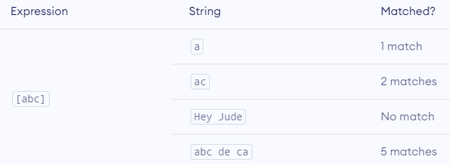
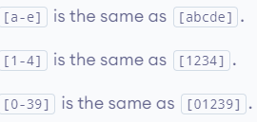
1) RegExp Flags (Cont’d)
A regular expression is created using a combination of a pattern and these flags to produce different results.
Eg:
// Match all instances of “at” in a string
var pattern1= /at/g;
//Match the first instance of “bat” or “cat”, regardless of case
var pattern2= /[bc]at/i;
//Match all three-character combinations ending with “at”, regardless of case
var pattern3=/.at/gi;
Using string search() method with a RegExp;
Using string match() method with a RegExp;
Using string replace() method with a RegExp;

Slide 83
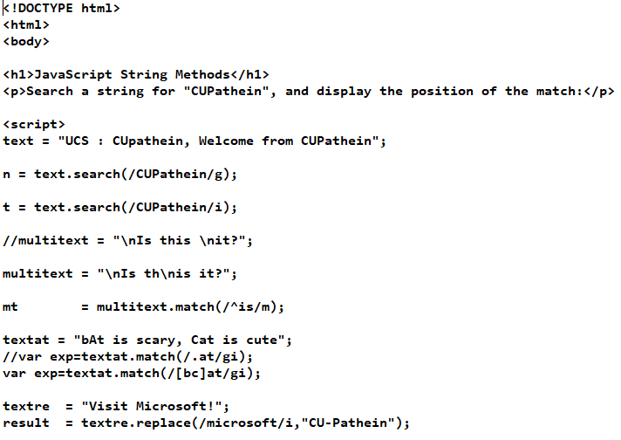
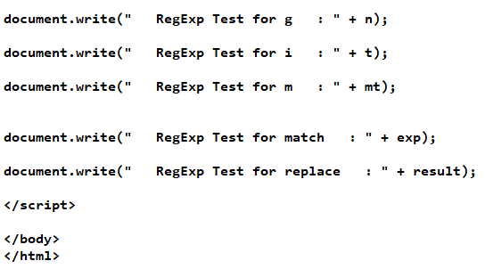
1) RegExp Flags Example

Slide 84
2) RegExp Metacharacters
Using RegExp Metacharacters
Metacharacters are characters that are interpreted in a special way by a RegExp engine.
The Metacharacters are as follows:
( [ { \ ^ $ | ) ] } ? * + .
Each metacharacter has one or more uses in regular expression syntax and so must be escaped by a backslash
//Match the first instance of “bat” or “cat”, regardless of case
var pattern1=/[bc]at/i;
//Match the first instance of “[bc]at”, regardless of case
var pattern2=/\[bc\]at/i;
//Match all three-character combinations ending with “at”, regardless of case
var pattern3=/.at/gi;
//Match all instances of “.at”, regardless of case
var pattern4=/\.at/gi;

Slide 85
2) RegExp Metacharacters (Cont’d)
All metacharacters must be double-escaped, as must characters that are already escaped, such as \n (the \ character, which is normally escaped in strings as \\ becomes \\\\ when used in a regular-expression string).
Some patterns in their literal form and the equivalent string that would be necessary to use the RegExp constructor.
Eg:
//Match the first instance of “bat” or “cat”, regardless of case
var pattern1=/[bc]at/i;
//Same as pattern1, just using the constructor
var pattern2=new RegExp(“[bc]at”, “i”) ;
(keep in mind that creating a regular expression using a literal is not exactly the same as creating a regular expression using the RegExp constructor.)
LITERAL PATTERN | STRING EQUIVALENT
/ \[bc\]at/ | “\\[bc\\]at”
/ \ .at/ | “\\ .at”
/name\/age/ | “name\\/age”
/ \d. \d{1,2}/ | “\\d . \\d{1,2}”
/ \w\\hello\\123/ | “\\w\\\\hello\\\\123”

Slide 86
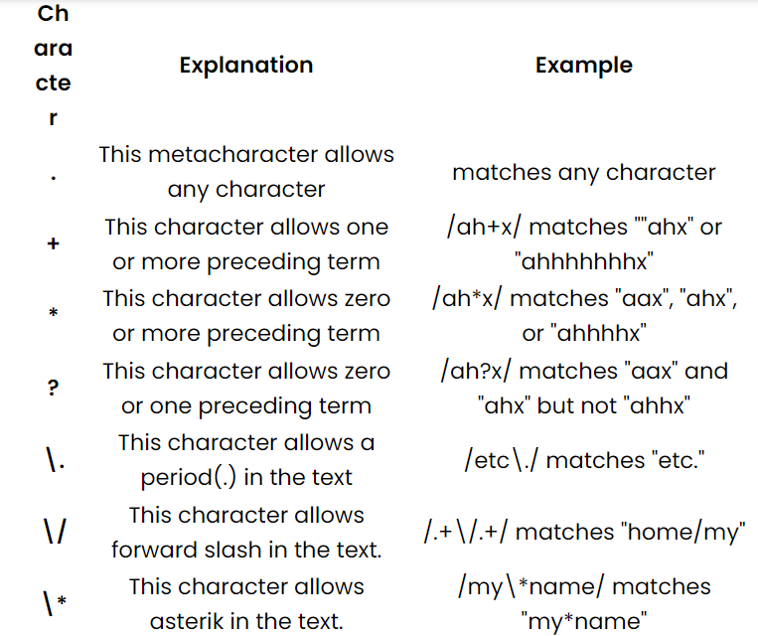
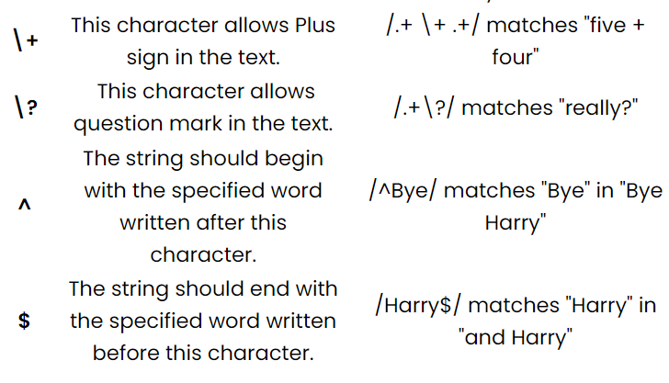
Using Regular Expression Metacharacters

Slide 87
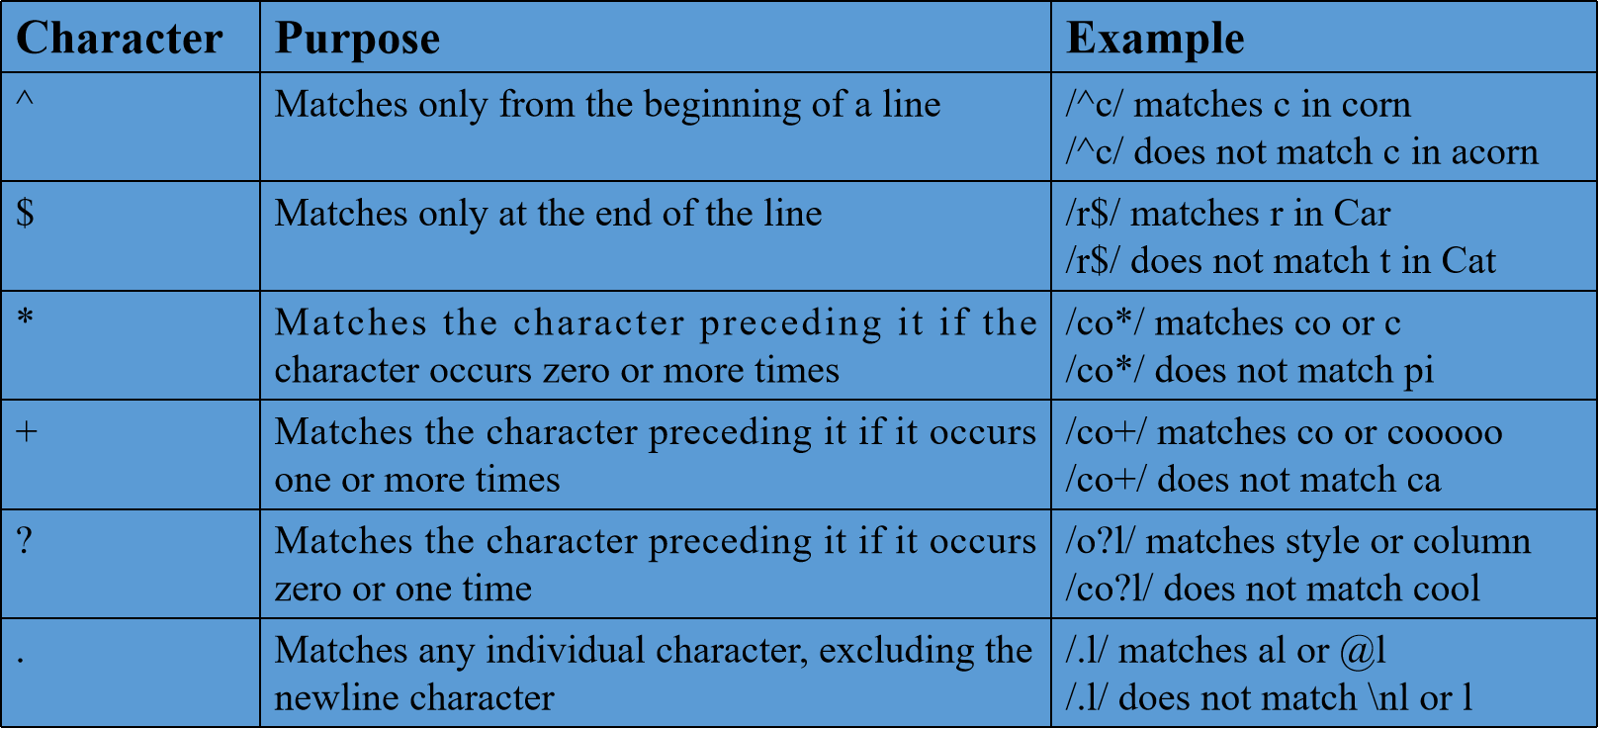
Using Regular Expression Metacharacters

Slide 88
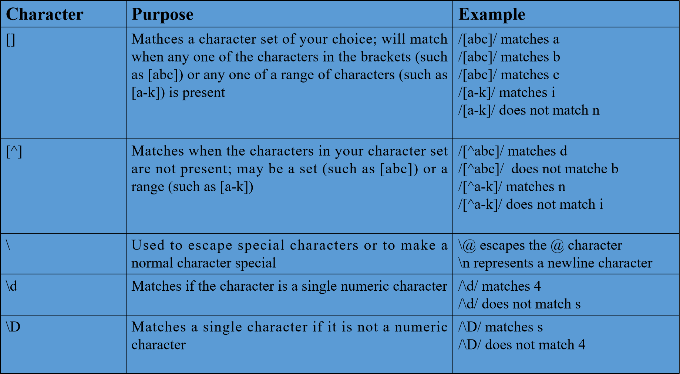
Using Regular Expression Metacharacters (Cont’d)

Slide 89
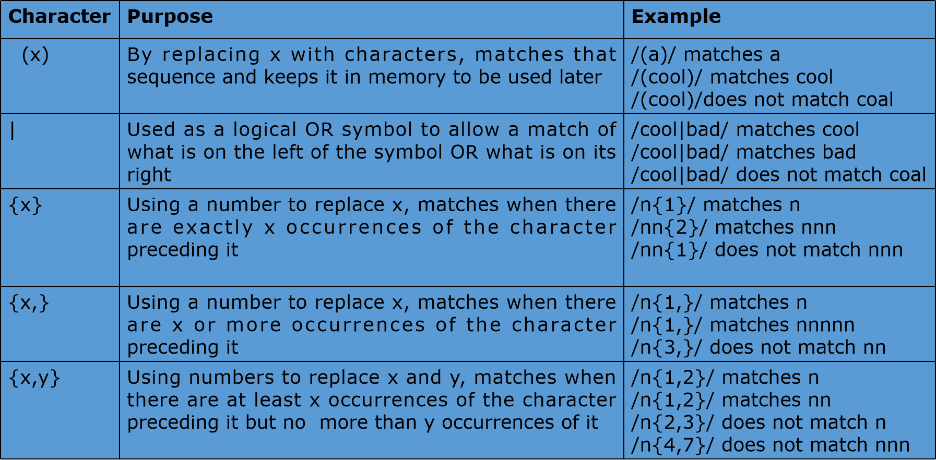
Using Regular Expression Metacharacters (Cont’d)

Slide 90
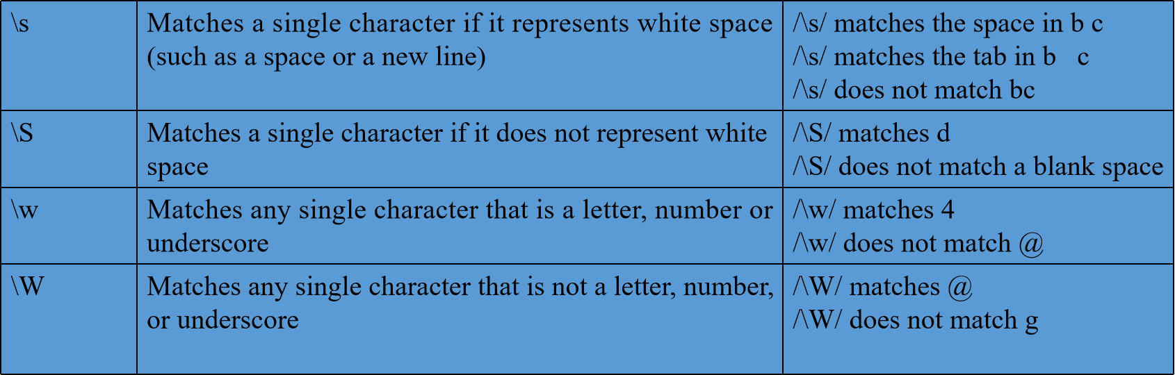
Using Regular Expression Metacharacters (Cont’d)

Slide 91
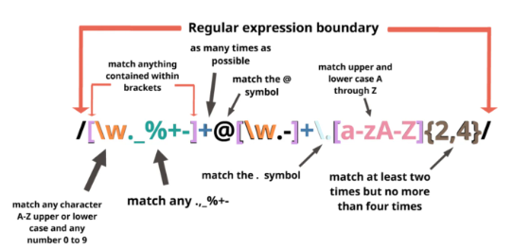
Example
<html>
<head>
<script language="javascript">
function check_it(){
var tomatch=/[A-Za-z0-9]\w{2,}@[A-Za-z0-9]{3,}\.[A-Za-z]{3}/;
var emadd=document.f1.t1.value;
if(tomatch.test(emadd)){
alert("E-mail address OK");
return true;}
else{
alert("E-mail address invalid. Please Try again");
return false;}}
</script></head>
<body>
<form name="f1" id="f1" action="page1.html" onSubmit="return check_it()">
Enter your email address:<br><input type="text" name="t1" id="t1"><br><input type="submit"></form></body></html>

Slide 92
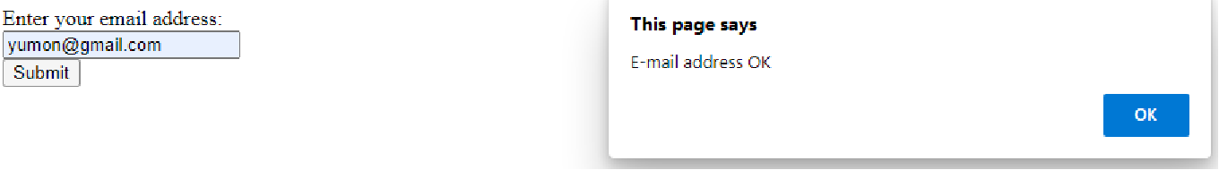
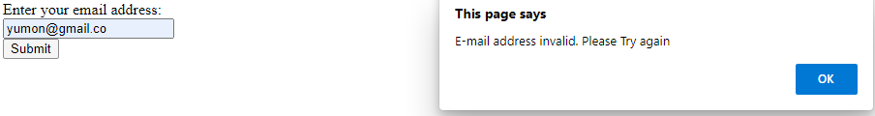
Example

Slide 93
RegExp Properties
Each instance of RegExp has the following properties that allow you to get information about the pattern:
global A Boolean value indicating whether the g flag has been set
ignoreCase A Boolean value indicating whether the i flag has been set
lastIndex An integer indicating the character position where the next match will be attempted in the source string. This value always begins as 0.
multiline A Boolean value indicating whether the m flag has been set.
source The string source of the regular expression. This is always returned as if specified in literal form (without opening and closing slashes) rather than a string pattern as passed into the constructor.
Eg:
var pattern1 = /\[bc\]at/i;
alert(pattern1.global); //false
alert(pattern1.ignoreCase); //true
alert(pattern1.multiline); //false
alert(pattern1.lastIndex); //0
alert(pattern1.source); //”\[bc\]at”
Eg:
var pattern2 = new RegExp(“\\[bc\\]at”, “i”);
alert(pattern2.global); //false
alert(pattern2.ignoreCase); //true
alert(pattern2.multiline); //false
alert(pattern2.lastIndex); //0
alert(pattern2.source); //”\[bc\]at”

Slide 94
RegExp Method
The test() method which accepts a string argument and returns true if the pattern matches the argument and false if it does not. This method is useful when you want to know if a pattern is matched, but you have no need for the actual matched text.
var text = “000-00-0000”;
var pattern = /\d{3}-\d{2}-\d{4}/;
if (pattern.test(text)){
alert(“The pattern was matched.”);
} //Output: The pattern was matched.
Eg:
var str= “Javascript is an interesting scripting language”;
var re= new RegExp(“script”, “g”);
var result= re.test(str);
document.write(“Test 1 – returned value:”+ result); //Output: Test 1 - returned value : true
re= new RegExp (“pushing”, “g”);
var result= re.test(str);
document.write(“Test 2 – returned value: “ + result); //Output: Test 2- returned value :false

Slide 95
RegExp Method (Cont’d)
The exec() method which is intended for use with capturing groups.
This method accept a single argument, which is the string on which to apply the pattern, the pattern, and returns an array of information about the first match or null if no match was found.
The returned array, though an instance of Array, contains two additional properties:
index, which is the location in the string where the pattern was matched, and
input, which is the string that the expression was run against.
In the array, the first item is the string that matches the entire pattern.
Any additional items represent captured groups inside the expression
( if there are no capturing groups in the pattern, then the array has only one item).

Slide 96
RegExp Method (Cont’d)
Eg:
var text = “cat, bat, sat, fat”;
var pattern1 = /.at/;
var matches = pattern1.exec(text);
alert(matches.index); //0
alert(matches[0]); //cat
alert(pattern1.lastIndex); //0
var pattern2 = /.at/g;
var matches = pattern2.exec(text);
alert(matches.index); //0
alert(matches[0]); //cat
alert(pattern2.lastIndex); //0
matches = pattern2.exec(text);
alert(matches.index); //5
alert(matches[0]); //bat
alert(pattern2.lastIndex); //8

Slide 97
RegExp Method (Cont’d)
var str= “Javascript is an interesting scripting language”;
var re= new RegExp(“script”, “g”);
var result= re.exec(str);
document.write(“Test 1 – returned value: “ + result); //Output: Test 1 – returned value : script
re= new RegExp (“pushing”, “g”);
var result= re.exec(str);
document.write(“<br> Test 2 – returned value: “ + result); //Output: Test 2- returned value :null

Slide 98
RegExp Constructor Properties
VERBOSE NAME | SHORT NAME | DESCRIPTION
input | $_ | The last string matched against. This is not implemented in Opera.
lastMatch | $& | The last matched text. This is not implemented in Opera.
lastPaern | $+ | The last matched capturing group. This is not implemented in Opera.
leftContext | $` | The text that appear in the input string prior to lastMatch.
Multiline | $* | A Boolean value specifying whether all expressions should use multiline mode. This is not implemented IE or Opera.
rightContext | $’ | The text that appears the input string after lastMatch.

Slide 99
RegExp Constructor Properties (Cont’d)
Eg:
var text = "this has been a short summer";
var pattern = /(.)hort/g;
if (pattern.test(text)){
alert(RegExp.input); //this has been a short summer
alert(RegExp.leftContext); //this has been a
alert(RegExp.rightContext); // summer
alert(RegExp.lastMatch); //short
alert(RegExp.lastParen); //s
alert(RegExp.multiline); //false
}
var text = "this has been a short summer";
var pattern = /(.)hort/g;
if (pattern.test(text)){
alert(RegExp.$_); //this has been a short summer
alert(RegExp["$`"]); //this has been a
alert(RegExp["$'"]); // summer
alert(RegExp["$&"]); //short
alert(RegExp["$+"]); //s
alert(RegExp["$*"]); //false

Slide 100
Outcome
Use regular expression Properties and Methods to validate any kind of input
Create a script that validates information from a form
Implement program logic using Regular Express Properties and Methods
Learn advanced regular-expression functionality

Slide 101
Web Technology JavaScript programming Chapter 5-3 : Reference Types
University of Computer Studies
Department of Information Technology Supporting and Maintenance

Slide 102
What is Primitive Wrapper Type?
There are three Primitive Wrapper Types in JavaScript.
1) the Boolean type, 2) the Number type, 3) the String type
Three Wrapper Types Primitive are designed to ease interaction with primitive values.
Each Primitive Wrapper Type has methods that make data manipulation easier.
Every time a primitive value is read, an object of the corresponding Primitive Wrapper Type is created behind the scenes, allowing access to any number of methods for manipulating the data.
Eg:
var s1 = “some text”;
var s2 = s1.substring(2);
//behind the scenes of the s1.substring(2)
var s1 = new String(“some text”); // create an instance of the String type
var s2 = s1.substring(2); // call the specified method on the instance
s1 = null; //destroy the instance

Slide 103
Boolean Type
The Boolean type is the reference type corresponding to the Boolean values.
To create a Boolean object, use the Boolean constructor and pass in either true or false.
The properties and methods of a Boolen object are available on all boolen primitives.
var booleanObject = new Boolean(true);
The problem typically occurs when trying to use Boolean objects in Boolean expressions, as in this example:
var falseObject = new Boolean(false); //a Boolean object is created with a value of false
var result = falseObject && true;
alert(result); //true
var falseValue = false;
result = falseValue && true;
alert(result); //false

Slide 104
String Type
The String type is the object that corresponds to the string values.
To create an object, a String constructor is used with a string being passed in
The properties and methods of a String object are available on all string primitives.
All three of the inherited methods – valueOf(), toLocaleString(), and toString() which return the object’s primitive string value.
var stringObject = new String(“hello world”);
Each instance of String contains a single property: length, which indicates the number of characters in the string.
Eg:
var s1 = “hello world”;
alert(s1.length); //”11”

Slide 105
Character Methods
charAt() Method
This charAt() method returns the character in the given position as a single-character string.
var s1 = “hello world”;
alert(s1.charAt(1)); //”e”
charCodeAt() Method
This charCodeAt() method returns the character’s character code instead of the actual character at the give index.
var s1 = “hello world”;
alert(stringValue.charCodeAt(1)); //outputs “101”

Slide 106
String-Manipulation Methods
concat() Method
The concat() method which is used to concatenate one or more strings to another, returning the concatenated string as the result.
var s1 = “hello “;
var s2 = stringValue.concat(“world”);
alert(s2); //”hello world”
alert(s1); //”hello”
trim() Method
The trim() method creates a copy of the string, removes all leading and trailing white space, and then returns the result.
var s1 = “ hello world “;
var s2 = s1.trim();
alert(s2); //”hello world”
alert(s1); //” hello world “

Slide 107
String Location Methods
indexOf() Method
The indexOf() method returns the character position index of the first occurrence of the search string. - 1 if no occurrence found.
var s1= “hello world”;
alert(s1.indexOf(“o”)); //4
lastIndexOf() Method
The lastIndexOf() method returns the index of the last occurrence of the search string. - 1 if none found.
var s1= “hello world”;
alert(s1.lastIndexOf(“o”)); //7

Slide 108
Number Type
The Number type is the reference type for numeric values.
To create a Number object, use the Number constructor and pass in any number.
The methods of a Numb object are available on all number primitives.
var numberObject = new Number(10);
toFixed() Method
The toFixed() method returns a string representation of a number with a specified number of decimal points.
var s1 = 10;
alert(num.toFixed(2)); //”10.00”
var num = 10.005;
alert(num.toFixed(2)); //”10.01”

Slide 109
Number Type (Cont’d)
toExponential() Method
Returns a string containing a number represented in exponential notation.
This method accepts one argument, which is the number of decimal places to output.
var s1 = 10;
alert(s1.toExponential(1)); //”1.0e+1”
toPrecision() Method
The toPrecision() method returns either the fixed or the exponential representation of a number.
This method takes one argument which is the total number of digits to use to represent the number(not including exponents).
var s1 = 99;
alert(s1.toPrecision(1)); //”1e+2”
alert(s1.toPrecision(2)); //”99”
alert(s1.toPrecision(3)); //”99.0”

Slide 110
Function Type
The functions are objects that are used to specify or encapsulate one or more statements.
A function may be run from any place inside a script and at any time.
That makes them very suitable for those groups of statements that have to be executed multiple times and by multiple objects within a script.
Each function is an instance of the Function type that has properties and methods just like any other reference type.
Because functions are objects, function names are simply pointers to function objects and are not necessarily tied to the function itself.

Slide 111
Function Type(Cont’d)
The length property simply returns the number of arguments passed to a function.
Example:
function sayName(name){
alert(name);
}
function sum(num1, num2){
return num1 + num2;
}
function sayHi(){
alert(“hi”);
}
alert(sayName.length); //1
alert(sum.length); //2
alert(sayHi.length); //0

Slide 112
Math Object
The Math object is a build-in, static object in JavaScript.
It’s functions and constants helps in mathematical calculations.
Since math is static it can be used directly to call all it’s constants and methods.
Math.max() Method
The Math.max() method returns the largest number in the list of arguments passed to it.
These methods accept any number of parameters.
var max = Math.max(3, 54, 32, 16);
alert(max); //54
Math.min() Method
The Math.min() method returns the lowest number in the list of arguments passed to it.
These methods accept any number of parameters.
var min = Math.min(3, 54, 32, 16);
alert(min); //3

Slide 113
Math Object (Cont’d)
Math.ceil() Method
The Math.ceil() method rounds a number UPWARDS to the nearest integer, and returns the result.
alert(Math.ceil(25.9)); //26
alert(Math.ceil(25.5)); //26
alert(Math.ceil(25.1)); //26
Math.floor() Method
The Math.floor() method rounds a number DOWNWARDS to the nearest integer, and returns the result.
alert(Math.floor(25.9)); //25
alert(Math.floor(25.5)); //25
alert(Math.floor(25.1)); //25

Slide 114
Math Object (Cont’d)
Math.round() Method
The Math.round() method represents a standard round function, which rounds up if the number is at least halfway to the next integer value (0.5 or higher) and rounds down if not.
alert(Math.round(25.9)); //26
alert(Math.round(25.5)); //26
alert(Math.round(25.1)); //25
Math.random() Method
The Math.random() method returns a random number between the 0 and the 1, not including either 0 or 1.
var num = Math.floor(Math.random() * 10 + 1);

Slide 115
Web Technology JavaScript programming Chapter 6 : Object-Oriented Programming
Department of Information Technology Supporting and Maintenance

Slide 116
Object Creation
Although using the object constructor or an object literal are convenient ways to create single objects, there is an obvious downside:
- multiple objects with the same interface requires a lot of code duplication.
To solve this problem, developers began using a variation of the factory pattern.
The factory pattern is a creational design pattern that provides a generic interface for creating objects.
Factory pattern can specify the type of object being created and don’t need to explicitly require a constructor.

Slide 117
1. Factory Pattern
Example:
//constructor function
function createPerson(name, age, job){
var o = new Object();
o.name = name;
o.age = age;
o.job = job;
//adding a method to the constructor function
o.sayName = function(){ alert(this.name); };
return o; }
var person1 = createPerson("Nicholas", 29, "Software Engineer");
var person2 = createPerson("Greg", 27, "Doctor");
person1.sayName(); //"Nicholas"
person2.sayName(); //"Greg"

Slide 118
2. Parasitic Constructor
Example :
//constructor function
function Person(name, age, job){
var o = new Object(); //creating an object
// add a property
o.name = name;
o.age = age;
o.job = job;
o.sayName = function(){alert(this.name); };
return o; }
//creating new object
var friend = new Person("Nicholas", 29, "Software Engineer");
friend.sayName(); //"Nicholas"
The parasitic constructor pattern is to create a constructor that simply wraps the creation and return of another object.
This is the same as the factory pattern except that the function is called as a constructor, using the new operator.
When a constructor doesn’t return a value, it returns the new object instance by default.
Adding a return statement at the end of a constructor allows to override the value that is returned when the constructor is called.

Slide 119
3. Constructor Pattern
Constructors in ECMAScript are used to create specific types of objects.
There are native constructors, such as Object and Array, which are available automatically in the execution environment at runtime.
In Example :
There is no object being created explicitly.
The properties and method are assigned directly onto this object.
There is no return statement
Constructor functions always begin with an uppercase letter, but nonconstructor function begin with a lowercase letter.
Example:
function Person(name, age, job){
this.name = name;
this.age = age;
this.job = job;
this.sayName = function(){alert(this.name); };
}
var person1 = new Person("Nicholas", 29, "Software Engineer");
var person2 = new Person("Greg", 27, "Doctor");
person1.sayName(); //"Nicholas"
person2.sayName(); //"Greg"

Slide 120
4. Prototype Pattern
The prototype pattern in javascript is a creational design pattern that allows to create objects that inherit properties and methods from a prototype object.
In example, the properties and the sayName() method are added directly to the prototype property of Person, leaving the constructor empty.
Example:
function Person(){ }
Person.prototype.name = "Nicholas";
Person.prototype.age = 29;
Person.prototype.job = "Software Engineer";
Person.prototype.sayName = function(){ alert(this.name); };
var person1 = new Person();
person1.sayName(); //"Nicholas"
var person2 = new Person();
person2.sayName(); //"Nicholas"

Slide 121
5. Combination Constructor + Prototype Pattern
The constructor pattern defines instance properties, whereas the prototype pattern defines methods and shared properties.
With this approach, each instance ends up with its own copy of the instance properties, but they all share references to methods.
In example : the instance properties are defined in the constructor, and the shared property constructor and the method sayName() are defined on the prototype.
Example:
function Person(name, age, job){ this.name = name;
this.age = age;
this.job = job; }
Person.prototype = {
constructor: Person,
sayName : function () {alert(this.name); }
};
var person1 = new Person("Nicholas", 29, "Software Engineer");
var person2 = new Person("Greg", 27, "Doctor");

Slide 122
6. Dynamic Prototype Pattern
The dynamic prototype pattern encapsulates all of the information within the constructor by initializing the prototype if needed.
In Example:
The highlighted section of code inside the constructor adds the sayName() method if it doesn’t already exist.
This block code is executed only the first time the constructor is called.
After that, the prototype has been initialized and doesn’t need any further modification.
Changes to the prototype are reflected immediately in all instances.
When using the dynamic prototype pattern, the prototype cannot overwrite using an object literal.
Because overwriting a prototype when an instance already exists effectively cuts off that instance from the new prototype.
Example :
function Person(name, age, job){
//properties
this.name = name;
this.age = age;
this.job = job;
//methods
if(typeof this.sayName != “function”){
Person.prototype.sayName = function(){alert(this.name); };
} }
var friend = new Person("Nicholas", 29, "Software Engineer");
friend.sayName();

Slide 123
7. Durable Constructor Pattern
A durable constructor is a constructor that follows a pattern similar to the parasitic constructor pattern, with two differences:
instance methods on the created object don’t refer to this,
the constructor is never called using the new operator.
Example:
function Person(name, age, job){
//create the object to return
var o=new Object();
//optional : define private variables/functions here
//attach methods
o.sayName = function() {
alert(name); };
//return the object
return o;
var friend = Person(“Nicholas”, 29, “Software Engineer”);
friend.sayName(); // “Nicholas”

Slide 124
Exercise
Ques:
Create an object named Person with properties(name, age, job) and a method named sayName which return the name of object with alert. Create an instance of object with "Nicholas", 29,"Software Engineer". Call the method of object. (Parasitic Constructor Pattern)
Ans:
function Person(name, age, job){
var obj = new Object();
obj.name = name;
obj.age = age;
obj.job = job;
obj.sayName = function( ){ alert(this.name); };
return obj; }
var person = new Person(“Nicholas”, 29, “Software Engineer”);
person.sayName( );

Slide 125
Web Technology JavaScript programming Chapter 6-1 : Object-Oriented Programming
Department of Information Technology Supporting and Maintenance

Slide 126
Objects
JavaScript uses objects to perform many tasks
It is referred to as an object-based programming language.
Objects have attributes and exhibit behaviors.
In JavaScript, almost “everything” is an object.
Booleans can be objects (if defined with the new keyword)
Numbers can be objects (if defined with the new keyword)
Strings can be objects (if defined with the new keyword)
Dates are always objects
Maths are always objects
Regular expressions are always objects
Arrays are always objects
Function are always objects
Objects are always objects (All JavaScript values, except primitives, are objects.)
//In JavaScript, objects are king. If you understand objects, you understand JavaScript.

Slide 127
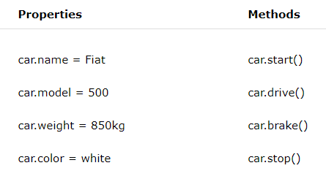
Objects (Cont’d)
Primitive Value and Data Type in JavaScript
A primitive value is a value that has no properties or methods. (eg. 3.14)
A primitive data type is data that has a primitive value. JavaScript defines 7 types of primitive data types: string, number, boolean, null, undefined, symbol, bigint
Example of Objects in real life
A car is an object.
A car has properties like weight and color, and
methods like start and stop, drive, move forward and backward.
All cars have the same properties, but
the property values differ from car to car.
All cars have the same methods, but
the methods are performed at different times.
Events : beep the horn

Slide 128
Objects – Methods, Properties
Methods
Methods are actions that can be performed on objects.
Object properties can be both primitive values, other objects, and functions.
An object method is an object property containing a function definition.
Methods are like functions, they do something
- When called from an event
When called from another method
Syntax: objectName.methodName( );
Eg: person.fullName( )
Properties
Some properties cannot be changed
Eg: body shape, number of wheels
Some properties can change
Eg: amount of gas in the tank
Speed of travelling

Slide 129
Creating Objects
Objects are variables but they can contain many values.
var person = new object();
person.name = “Nichloas”;
person.age = 29; (OR)
JavaScript objects are written with curly braces {}.
var person = { name:”Nicholas”, age:29};(or)var person={name:”Nicholos”,age:29,};
//, trailing comma -> (sometimes called "final commas") can be useful when adding new elements, parameters, or properties to JavaScript code.
(OR)
var person = {};
person.name = “Nichloas”;
person.age = 29;
alert(person[“name”]); // Nichloas
alert(person.name); // Nichloas
alert(person.age); //29

Slide 130
Objects Properties ( Adding, Deleting )
Adding new properties to an existing object by simply giving it a value.
Eg: const person = {
firstname: "John",
lastname: "Doe",
age: 50,
eyecolor: "blue"
};
person.nationality=“English”;
person[“age”]=51;
Deleting properties from an object using delete keyword.
Eg: const person = {
firstname: "John",
lastname: "Doe",
age: 50,
eyecolor: "blue"
};
delete person.age; //undefined

Slide 131
Objects Creation
Factory Pattern
Parasitic Constructor Pattern
Constructor Pattern
Prototype Pattern
Combination Constructor + Prototype Pattern
Dynamic Prototype
Durable Constructor pattern

Slide 132
Web Technology JavaScript programming Chapter 7 : Function Expressions
University of Computer Studies
Department of Information Technology Supporting and Maintenance

Slide 133
Function
Functions are actually objects in JavaScript.
A function is a block of JavaScript code that is defined once but may be executed, or invoked, any number of times.
A function can be used to return a value, construct an object or as a mechanism to simply run code.
There are two ways to define a function: function declaration and function expression.
Functions in ECMAScript are declared using the function keyword, followed by a set of arguments and then the body of the function.
Syntax :
function functionName(arg0, arg1,...,argN) { statements }
Example :
function sayHi(name, message) {
alert(“Hello “ + name + “, “ + message); }

Slide 134
Function (Cont’d)
Advantages of Function
Number of lines code is reduced
Code becomes easier to read and understand
Code becomes easier to maintain as changes need to be made only at a single location instead multiple locations.
Function Type
The functions are objects that are used to specify or encapsulate one or more statements.
A function may be run from any place inside a script and at any time. That makes them very suitable for those groups of statements that have to be executed multiple times and by multiple objects within a script.
Each function is an instance of the Function type that has properties and methods just like any other reference type.
Because functions are objects, function names are simply pointers to function objects and are not necessarily tied to the function itself.
Function Parameters
Facility to pass different parameters when calling a function
Passed parameter can be captured inside the function and any manipulation can be done over those parameters.
A function can take multiple parameters separates by comma.

Slide 135
Function (Cont’d)
1) Function Declaration
function fun1(){console.log(“Hello”);}fun1();
Eg: function sum(n1,n2){
return n1+n2;}
sum(1,2);
2) Function Expression
Any time a function is being used as a value, it is a function expression
Function expressions must be assigned before usage
var fun1=function(){console.log(“Hello”);};fun1();
Eg: var sum=function(n1,n2){
return n1+n2;
}
sum(1,2);

Slide 136
Function (Cont’d)
3) Anonymous Function
setTimeout(function(){console.log(“Hello”);},1000);
4) Immediately Invokable function Expression (IIFE)
Function expressions can be made "self-invoking“.
define and invoke at the same time
(function( ){console.log(“Hello”) ;}) ( );
Eg: console.log((function(a,b)) {
return a+b;
})(2,3); //5 – after the anonymous function is declared, passing 2,3 immediately
5) JavaScript functions can be used as values.
Eg: function myFunc (a,b){
return a*b;}
let res=myFunc (3,2);
console.log(res);

Slide 137
Function (Example)
Eg: function sum(a.b)
{return a+b;}
function circle(c)
{const PI*r*r;}
function greeting( )
{console.log(“Hi”);}
function sayHello(name)
{console.log(`Hello ${name}`);}
sum(2,6); //8
circle(2); //28.26
greeting( ); //Hi
sayHello(“Angela”); // Hello Angela
Eg:
sayHi();
var sayHi = function(){
alert(“Hi!”);
};
// error – function doesn’t exist yet
Eg:
var sayHi;
if(condition){
sayHi = function(){
alert(“Hi!”);
};
} else {
sayHi = function(){
alert(“Yo!”);
};
//valid example

Slide 138
Default and Rest Parameters (Example)
Eg1: function sum(a,b){
return a+b;}
sum(1,2,3,4); //3
sum(1); //NaN – not pass any second argument
Eg2: function sum (a ,b=1){
return a+b; }
sum (1,2);//3 – calculate with argument
sum(1);//2 – if no argument is provided , default parameter value is taken
Eg3: function sum(a, b,…c){
console.log(c)}
sum(1,2,3,4,5);//3,4,5

Slide 139
Function Hoisting
Hoisting is JS's default behavior of defining all the declarations at the top of the scope before code execution (to the top of the current script or the current function).
Variables defined with let and const are hoisted to the top of the block, but initialized. (the block of code is aware of the variable, but it cannot be used until it has been declared.
Eg1: sum(1,2) //3
function sum(a,b){
return a+b;}
Using a let variable before it is declared will result in a ReferenceError.
The variable is in a “temporal dead zone” from the start of the block until it is declared.
Eg2: sum(1,2); //ReferenceError
let sum=function(a,b){
return a+b;}
Eg3: myFunction (5) //25
function myFunction (y)
{ return y* y;
}

Slide 140
Function (Global Variable)
Eg: let name=“Angela”;
function welcome( ){
console.log(`Welcome ${name}`)
}
function hello( ){
console.log(`Hello ${name}`)
}
welcome( ); //Welcome Angela
hello( ); //Hello Angela
Eg: function welcome( ){
let name=“Angela”;
console.log(`Welcome ${name}`)
}
function hello( ){
console.log(`Hello ${name}`)
}
welcome( ); //Welcome Angela
hello( ); //Hello

Slide 141
Recursion
A recursive function is formed when a function calls itself by name.
Example :
function factorial(num){
if (num <= 1){
return 1;
} else {
return num * factorial(num-1);
}
} //classic recursive factorial function

Slide 142
Closures
Closures are functions that have access to variables from another function’s scope.
In JavaScript, closures are created every time a function is created, at function creation time.
Example :
function createComparisonFunction(propertyName) {
return function(object1, object2){
var value1 = object1[propertyName];
var value2 = object2[propertyName];
if (value1 < value2){
return -1;
} else if (value1 > value2){
return 1;
} else {
return 0;
}
};
}
// part of the inner ( anonymous ) function (accessing a variable ( propertyName ) from the outer function)

Slide 143
Closures and Variables
Closure gets the last value of any variable from the containing function.
It stores a reference to the entire variable object, not just to a particular variable.
Example :
function createFunctions(){
var result = new Array();
for (var i=0; i < 10; i++){
result[i] = function(){
return i;
};
}
return result;
}
//this function returns an array of functions (the function in position 0 returns 0, and so on)

Slide 144
Closures and Variables (Cont’d)
Instead of assigning a closure directly into the array, an anonymous function is defined and called immediately.
Example :
function createFunctions(){
var result = new Array();
for (var i=0; i < 10; i++){
result[i] = function(num){
return function(){
return num;
};
}(i);
}
return result;
}
//each function in the result array has its own copy of num and thus can return separate numbers

Slide 145
The this Object
The this object is bound at runtime based on the context in which a function is executed.
Example :
var name = “The Window”;
var object = {
name : “My Object”,
getNameFunc : function(){
return function(){
return this.name;
};
}
};
alert(object.getNameFunc()());
//”The Window” (global name variable)
Example :
var name = “The Window”;
var object = {
name : “My Object”,
getNameFunc : function(){
var that = this;
return function(){
return that.name;};
}
};
alert(object.getNameFunc()()); //”My Object”
//inner function can’t directly access from outer function

Slide 146
The this Object (Cont’d)
Consider the following modification to the previous example:
var name = “The Window”;
var object = {
name : “My Object”,
getName: function(){
return this.name;
}
};
object.getName(); //”My Object” (this.name)
(object.getName)(); //”My Object” (object.name)
(object.getName = object.getName)();
//”The Window” (the value of this assignment expression is the function itself, the this value is not maintained, and “The Window” is returned)

Slide 147
Private Variables
JavaScript has no concept of private members; all object properties are public.
Any variable defined inside a function is considered private.
function add(num1, num2){
var sum = num1 + num2;
return sum;
} //three private variables: num1, num2, and sum
A privileged method is a public method that has access to private variables and/or private functions.
There are two ways to create privileged methods on objects.

Slide 148
Private Variables (Cont’d)
This pattern defines all private variables and functions inside the constructor.
The privileged methods can be created to access those private members.
The privileged methods, when defined in the constructor, become closures with full access to all variables and functions defined inside the constructor’s scope.
In this example, the variable privateVariable and the function privateFunction() are accessed only by publicMethod().
Example :
function MyObject(){
//private variables and functions
var privateVariable = 10;
function privateFunction(){
return false;
}
//privileged methods
this.publicMethod = function (){
privateVariable++;
return privateFunction();
};
}

Slide 149
Static Private Variables
Privileged methods can also be created by using a private scope to define the private variables or functions.
Example explanation :
In this pattern, a private scope is created to enclose the constructor and its methods.
The private variables and functions are defined first, followed by the constructor and the public methods.
Public methods are defined on the prototype, as in the typical prototype pattern.
Note that this pattern defines the constructor by using a function expression.
Example :
(function(){
//private variables and functions
var privateVariable = 10;
function privateFunction(){
return false; }
//constructor
MyObject = function(){
};
//public and privileged methods
MyObject.prototype.publicMethod = function(){
privateVariable++;
return privateFunction();
};
})();

Slide 150
Static Private Variables (Cont’d)
The privileged method always holds a reference to the containing scope.
Example explanation :
The Person constructor in this example has access to the private variable name, as do the getName() and setName() methods.
Using this pattern, the name variable becomes static and will be used among all instances.
This means calling setName() on one instance affects all other instances.
Calling setName() or creating a new Person instance sets the name variable to a new value.
This causes all instances to return the same value.
Example :
(function(){
var name = “”;
Person = function(value){
name = value;
};
Person.prototype.getName = function(){
return name;
};
Person.prototype.setName = function (value){
name = value;
};
})();
var person1 = new Person(“Nicholas”);
alert(person1.getName()); //”Nicholas”
person1.setName(“Greg”);
alert(person1.getName()); //”Greg”
var person2 = new Person(“Michael”);
alert(person1.getName()); //”Michael”
alert(person2.getName()); //”Michael”

Slide 151
Web Technology JavaScript programming Chapter 8 : The Browser Object Model
University of Computer Studies
Department of Information Technology Supporting and Maintenance

Slide 152
The Browser Object Model (BOM)
The Browser Object Model (BOM) is used to interact with the browser.
The BOM is a hierarchy of browser objects that are used to manipulate methods and properties associated with the Web browser itself.
These BOM provides access to the various characteristics of a browser (Browser window itself, Screen characteristics, Browser history etc…..)
By using BOM, can modify, move the window or can change the text in status bar, read the current URL, go back or forward of the current page.
If a document contain frames(<iframe> tags), the browser creates one window object for the HTML document, and one additional window object for each frame.

Slide 153
The Window Object
The window object is supported by all browsers. It represents the browser's window.
All global JavaScript objects, functions and variables automatically become members of the window object.
Global variables are properties of the window object.
Global functions are methods of the window object.

Slide 154
The Global Scope
A variable named age and a function named sayAge() are defined in the global scope, which
automatically places them on the window object.
Example :
var age=29;
function sayAge(){ alert(this.age);
}
aert(window.age); //29
sayAge(); //29
window.sayAge(); //29

Slide 155
The Global Scope (Cont’d)
Global variables cannot be removed using the delete operator, while properties defined directly on window can.
Example :
var age =29;
window.color="red";
//throws an error IE<9, return false in all other browsers
delete window.age; //return false
//throws an error in IE<9,, returns true in all other browsers
delete window.color; //return true
alert(window.age); //29
alert(window.color); //undefined

Slide 156
Window Relationships and Frames
If a page contain frames, each frame has its own window object and is stored in the frames collection.
Within the frames collection, the window objects are indexed both by number (starting at 0, going from left to right, and then row by row) and by the name of the frame.
Each window object has a name property containing the name of the frame.
A framed page is made up of multiple HTML pages.

Slide 157
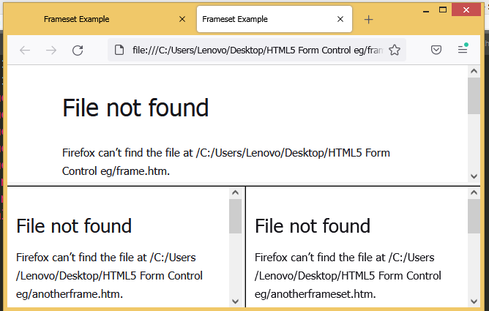
Window Relationships and Frames (Cont’d)
Example :
<html>
<head><title>Frameset Example</title></head>
<frameset rows="160,*">
<frame src="frame.html" name="topFrame">
<frameset cols="50%,50%">
<frame src="anotherframe.html" name="leftFrame">
<frame src="yetanotherframe.html" name="rightFrame">
</frameset>
</frameset>
</html>

Slide 158
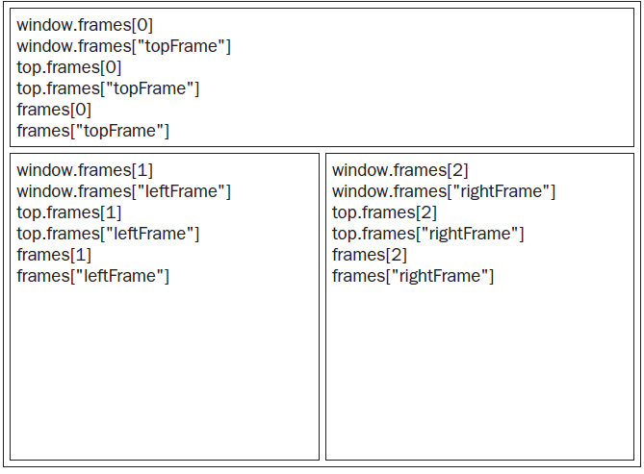
Window Relationships and Frames (Cont’d)
Figure – indicates the various ways that the frames may be accessed from code that exists in the topmost window.

Slide 159
Window Position
The position of a window object may be determined and changed using various properties and methods.
Window Move
//move the window to the upper-left coordinate
winow.moveTo(0, 0);
//move the window down by 100 pixels
window.moveBy(0,100);
//move the window to position (200, 300)
window.moveTo(200, 300);
//move the window left by 50 pixels
window.moveBy(-50, 0);

Slide 160
Window Size
The different properties can be used to determine the size of the browser window (the browser view, NOT including toolbars and scrollbars).
For Internet Explorer, Chrome, Firefox, Opera, and Safari:
window.innerHeight - the inner height of the browser window
window.innerWidth - the inner width of the browser window
For Internet Explorer 8, 7, 6, 5:
document.documentElement.clientHeight
document.documentElement.clientWidth
( or )
document.body.clientHeight
document.body.clientWidth

Slide 161
Window Size , Methods
Window Size
resizeTo() - method resizes a window to the specified width and height.
resizeBy() - Resizes the window by the specified pixels
window.resizeTo(100, 100); //resize to 100 x 100
window.resizeBy(100, 50); //resize to 200 x 150
window.resizeTo(300, 300); //resize to 300 x 300
Window Methods
window.open() - open a new window
window.close() – close the current window
window.moveTo() – move the current window
window.resizeTo() – resize the current window

Slide 162
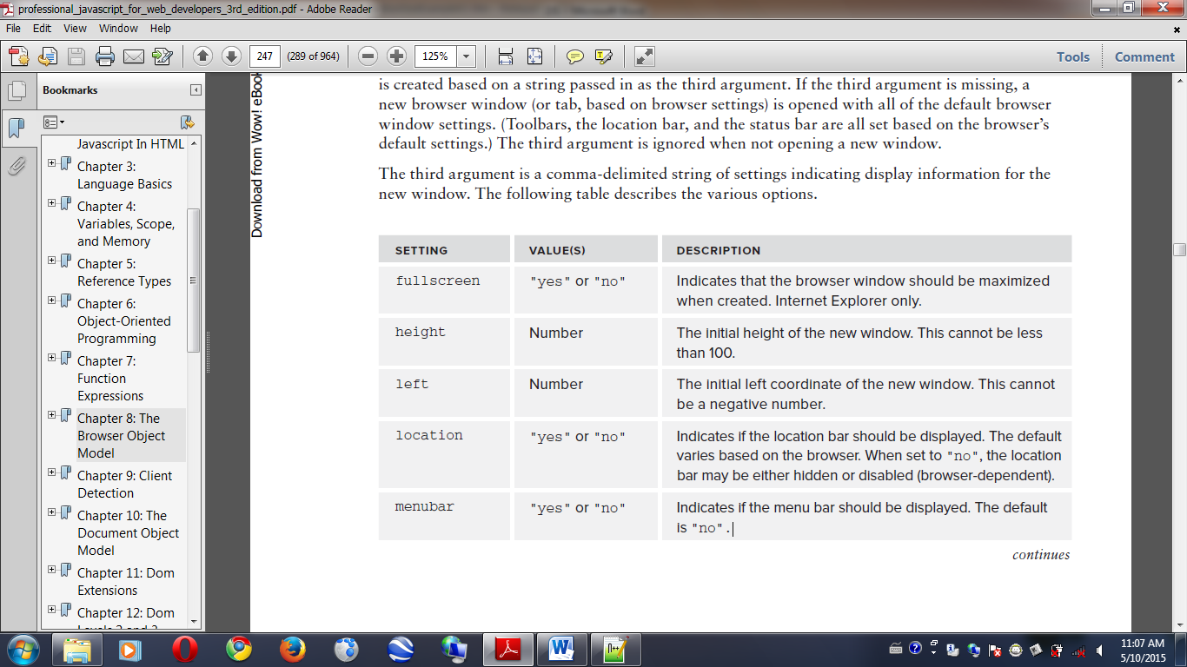
Navigating and Opening Window
Table 1: The various options for new window (Part-1)
Popping Up Windows
A popup window is one of the oldest methods to show additional document to user.
Most modern browsers are configured to open url in new tabs instead of separate windows.
Syntax:
window.open
(“http://www.wrox.com/”, “topFrame”);

Slide 163
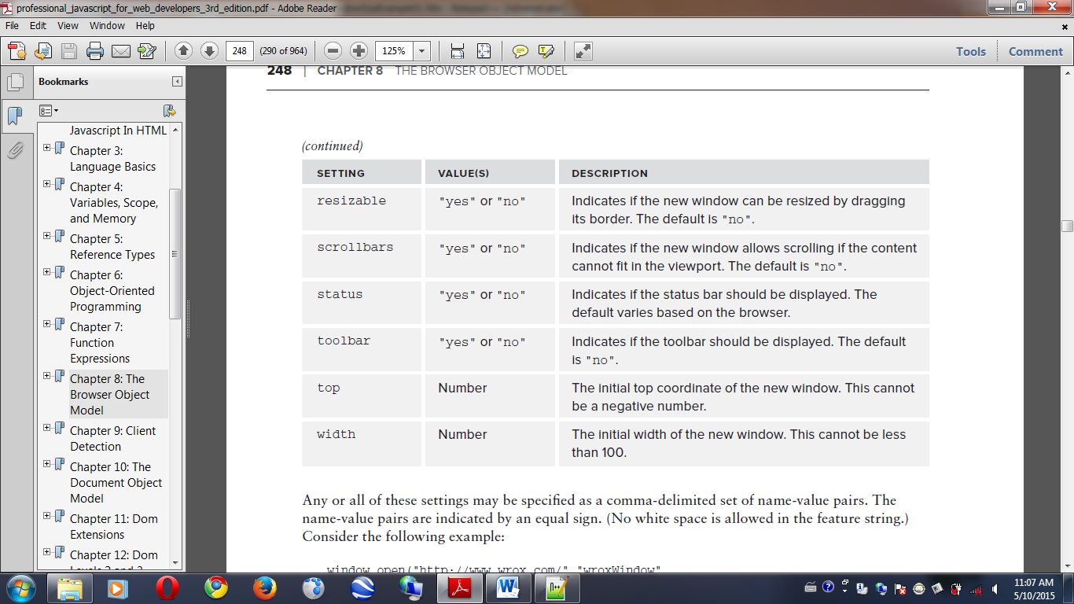
Navigating and Opening Window (Cont’d)
Table 1: The various options for new window (Part-2)
window.open(“http://www.wrox.com/”,”wroxWindow”, “height=400,width=400,top=10,left=10,resizable=yes”);

Slide 164
Navigating and Opening Window (Cont’d)
<html>
<head>
<title>Window Open Example</title>
</head>
<body>
<p>This will open a new window/tab:
<input type="button" value="Go to Wrox.com" onclick="window.open('http://www.wrox.com/')" /></p>
<p>This will open in the current window/tab:
<input type="button" value="Go to Wrox.com" onclick="window.open('http://www.wrox.com/', '_self')" /></p>
</body>
</html>

Slide 165
Intervals and Timeouts
Timeouts execute some code after a specified amount of time
Intervals execute code repeatedly, waiting a specific amount of time in between each execution.
setTimeout(function,milliseconds) method
Executes a function, after waiting a specified number of milliseconds.
1 second → 1000miliseconds
Eg:
const myTimeout=setTimeout(myGreeting,5000);
setInterval(function, millisecconds)
Same as setTimeout(), but repeats the execution of the function continuously
Eg:
const myInterval=setInterval(displayHello, 1000);

Slide 166
Intervals and Timeouts (Cont’d)
clearTimeout() method
The clearTimeout() method stops the execution of the function specified in setTimeout() method.
The clearTimeout() method clears a timer set with the setTimeout() method.
Syntax: clearTimeout(timeoutVariable)
Eg:
const myTimeout=setTimeout(myGreeting,5000);
function mystopfunction(){
clearTimeout(myTimeout );}
clearInterval() method
The clearInterval() method clears a timer set with the setInterval() method.
Syntax: clearInterval(intervalVariable);
Eg:
const myInterval=setInterval(myTimer, 1000);
function myStopFunction(){
clearInterval(myInterval );}

Slide 167
System Dialogs
Method to open a new window with some parameters
Method | Description
Window.alert() | Display alert box with OK button
Window.confirm() | Displays a confirmation dialog box with OK and Cancel button
Window.prompt() | Displays a prompt dialog box to get user input

Slide 168
System Dialogs (Cont’d)
alert () method
<html><head><title>Alert</title></head>
<body>
<script type="text/javascript">
alert("My name is Tayza");
window.alert("Welcome to programmingknowledge.blogspot.com");
</script></body></html>
Prompt box
<html><head><title>Prompt Dialog box</title></head>
<body>
<script type="text/javascript">
var y=window.prompt("Please enter your name:")
if(y) window.alert(“your name is ” +y)
else window.alert("You are Nameless man.");
</script></body></html>

Slide 169
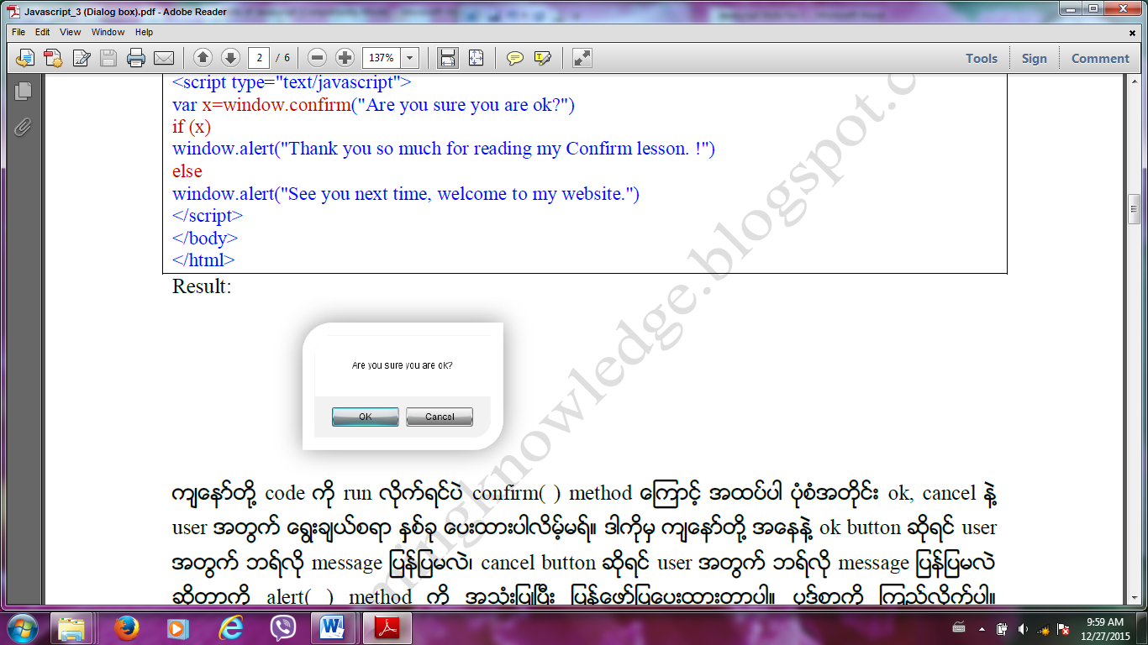
System Dialogs (Cont’d)
Confirm box
<html><head><title>CONFIRM</title></head>
<body>
<script type="text/javascript">
var x=window.confirm("Are you sure you are ok?")
if (x)
window.alert("Thank you so much for reading my Confirm lesson. !")
else
window.alert("See you next time, welcome to my website.")
</script></body></html>

Slide 170
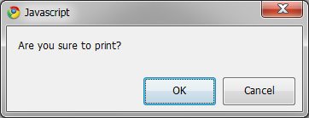
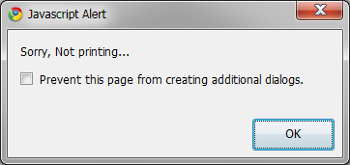
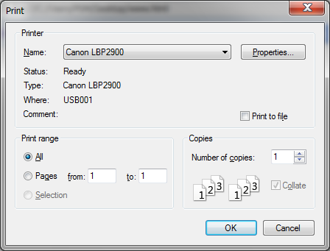
System Dialogs (Cont’d)
print Dialogs
<html><head><title>Window Printing</title></head>
<body>
<script type="text/javascript">
if(confirm("Are you sure to print?")){
window.print();
}else{
alert("Sorry, Not printing...");
}
</script></body></html>

Slide 171
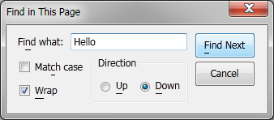
System Dialogs (Cont’d)
Find Dialogs
<html><head><title>Window Printing</title></head>
<body>
<script type="text/javascript">
if(confirm("Do you want to find any word?")){
window.find( );
}else{
alert("Sorry, Not printing...");
}
</script></body></html>

Slide 172
Web Technology JavaScript programming Chapter 10 : The Document Object Model (Hierarchy of Nodes)
University of Computer Studies
Department of Information Technology Supporting and Maintenance

Slide 173
What is DOM ?
The Document Object Model (DOM) is an application programming interface (API) for HTML and XML documents.
When a web page loading, the browser creates a Document Object Model of the page.
DOM represents a document as a hierarchical tree of nodes.
In the HTML DOM ,everything is a node.
To add, remove, and modify individual parts of the page.
- The document itself is a document node.
- All HTML elements are element nodes.
- All HTML attributes are attribute nodes.
- Text inside HTML elements are text nodes.
- Comments are comment nodes.

Slide 174
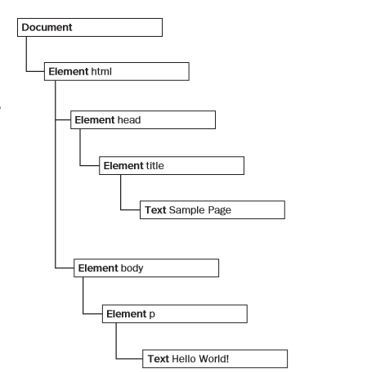
Hierarchy of Node
<!DOCTYPE html>
<html>
<head>
<title>Sample Page</title>
</head>
<body>
<p>Hello World!</p>
</body>
</html>

Slide 175
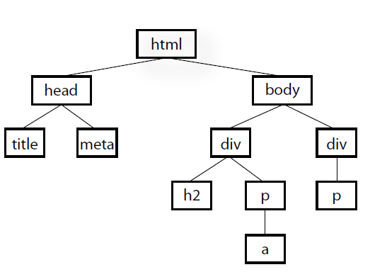
Hierarchy of Node (Cont’d0
<html>
<head>
<title>Document title</title>
<meta charset="utf-8">
</head>
<body>
<div>
<h2>Subhead</h2>
<p>Paragraph text with a <a href="foo.html">link</a> here.</p>
</div>
<div>
<p>More text here.</p>
</div>
</body>
</html>

Slide 176
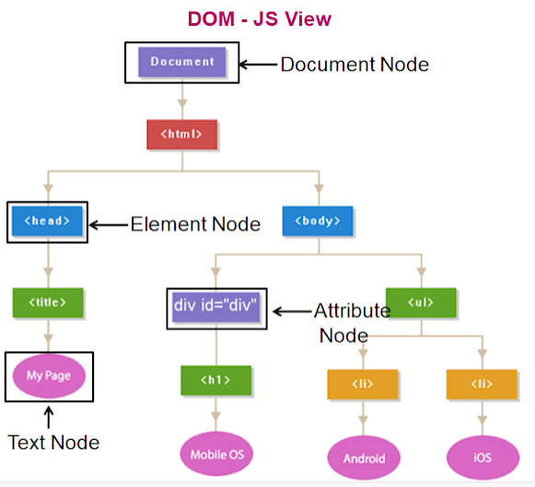
Hierarchy of Node (Cont’d0
<!DOCTYPE html>
<html>
<head>
<title>My Page</title>
</head>
<body>
<div id="div">
<h1>Mobile OS</h1>
</div>
<ul>
<li>Android</li>
<li>iOS</li>
</ul>
</body>
</html>

Slide 177
The Node Type
Every node has a nodeType property that indicates the type of node that it is.
The nodeType property returns the node type, as a number, of the specified node.
If the node is an element node, the nodeType property will return 1.
If the node is an attribute node, the nodeType property will return 2.
If the node is a text node, the nodeType property will return 3.
If the node is a comment node, the nodeType property will return 8.
Node types are represented with 12 numeric constants on the Node type.
Node.ELEMENT_NODE (1)
Node.ATTRIBUTE_NODE (2)
Node.TEXT_NODE (3)
Node.COMMENT_NODE (8)
Node.DOCUMENT_NODE (9)
Node.DOCUMENT_TYPE_NODE (10)

Slide 178
The nodeName and nodeValue Properties
The Document Type
nodeName is “#document”.
nodeValue is null.
The Element Type
nodeName is the element’s tag name.
nodeValue is null.
The Text Type
nodeName is “#text”.
nodeValue is text contained in the node.
The Attr Type
nodeName is the attribute name.
nodeValue is the attribute value.

Slide 179
Node Relationships
Each node has a childNodes property containing a NodeList.
A NodeList is an array-like object used to store an ordered list of nodes that are accessible by position.
A NodeList object is a list (collection) of nodes extracted from a document.
Accessing childNodes :
- firstChild (or) childNodes [0] (or) childNodes.item (0)
- childNodes [1] (or) childNodes.item (1)
- lastChild (or) childNodes [childNodes.length-1]
- previousSibling
- nextSibling
No.of childNodes :
- childNodes.length

Slide 180
Node Relationships (Cont’d)
ul
<ul>
<li> One</li>
<li>Two</li>
<li>Three</li>
</ul>
firstChild
parentNode
lastChild
parentNode
parentNode
nextSibling
nextSibling
li
li
li
previousSibling
previousSibling

Slide 181
The Document Object
When an HTML document is loaded into a web browser, it becomes a document object.
A document object is
- the root node of the HTML document
- the “owner” of all other nodes:( element nodes, text nodes, attribute nodes, and comment
nodes)
- provides properties and methods to access all nodes objects, from within JavaScript

Slide 182
Property and Methods of Document Object
Methods /Property Description
document.getElementById() finding an element by element id
document.getElementsByTagName() finding an elements by tag name
document.getElementsByClassName() finding an elements by class name
element.setAttribute(attribute, value) Change the attribute value of an HTML element
element.getAttribute(attribute) Retrieve the attribute value of an HTML element
document.createElement() Create an HTML element
document.createAttribute() Create an HTML attribute
document.createTextNode() Create Text Node
element.innerHTML=new html content getting or replacing the content of HTML elements
element. attribute = new value Change the attribute value of an HTML element
element.style.property= new style Change the style of an HTML element

Slide 183
createElement( ) and createTextNode( )
In HTML
<body>
<p>Hello World!</p>
</body>
Using DOM
var p=document.createElement(“p”);
var txt=document.createTextNode(“Hello World!”);
p.appendChild(txt);
//append to the element
document.body.appendChild(p);

Slide 184
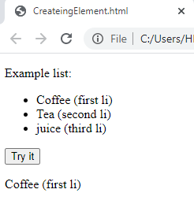
innerHTML Property
<p>Example list:</p>
<ul> <li>Coffee (first li)</li>
<li id="item">Tea (second li)</li>
<li>juice (third li) </li> </ul>
<button onclick="myFunction()">Try it</button>
<p id="demo"></p>
<script>
function myFunction() {
var x = document.getElementById("item2").previousSibling.innerHTML;
document.getElementById("demo").innerHTML = x;
}</script>

Slide 185
Creating Attribute Node
In HTML
<body>
<div id= “myNewDiv” class= “box” >Hello! </div>
</body>
Using DOM
var thediv=document.createElement(“div”);
thediv.id=“ myNewDiv”;
thediv.className= “box”;
(OR)
thediv.setAttribute(“id”, “myNewDiv”);
thediv.setAttribute(“className”, “box”);
(OR)
var theattr=document.createAttribute (“id”);
id.value= “myNewDiv”;
thediv.setAttribute(theattr);
thediv.appendChild(document.createTextNode(“Hello!”));
document.body.appendChild(thediv);
//The element can be added to the document tree.

Slide 186
DOM Standard Attributes
HTML attributes (DOM Standard Attributes) : id, title, lang, dir (ltr, rtl) , classname
Number of Attributes
element.attributes.length;
Eg: (In Html)
<body>
<div id= “mydiv” class=”bd” title=”Body Text” lang=”en” dir= “ltr”> Hello!</dir>
</body>
Eg: (In DOM)
<body>
<script type=”text/javascript”>
var div=document.createElement(“div”);
div.id= “mydiv”;
div.classname= “bd”;
div.title=”Body Text”;
div.lang=”en”;
div.dir=”ltr”;
div.appendChild(document.createTextNode(“Hello!”));
document.body.appendChild(div);
</script>
</body>

Slide 187
Getting Attribute
Eg : (In HTML)
<div id=”myDiv” class=”bd” title=”Body text” lang=”en” dir=”ltr”></div>
All of the information specified by this element may be retrieved using the following JavaScript code:
var div = document.getElementById(“myDiv”);
alert(div.id); //”myDiv”
alert(div.className); //”bd”
alert(div.title); //”Body text”
alert(div.lang); //”en”
alert(div.dir); //”ltr”

Slide 188
Getting Attributes (Cont’d)
var div = document.getElementById(“myDiv”);
alert(div.getAttribute(“id”)); //”myDiv”
alert(div.getAttribute(“class”)); //”bd”
alert(div.getAttribute(“title”)); //”Body text”
alert(div.getAttribute(“lang”)); //”en”
alert(div.getAttribute(“dir”)); //”ltr”
<div id=”myDiv” my_special_attribute=”hello!”></div>
var value = div.getAttribute(“my_special_attribute”);
alert(value); //hello!

Slide 189
Changing Attribute Value
To change each of the attributes by assigning new values to the properties:
div.id = “someOtherId”;
div.className = “ft”;
div.title = “Some other text”;
div.lang = “fr”;
div.dir =”rtl”;

Slide 190
Manipulating Nodes
appendChild( )
- add an HTML Element ( accept one argument: new node, add a node to end of childNodes list, return new node)
insertBefore( )
- accept two arguments: node to insert and node to reference, insert new node before reference node, return new node
replaceChild()
- replace an HTML Element ( accept two arguments: the node to insert and the node to replace, return node to replace)
removeChild( )
- Remove an HTML element (accept one argument: node to remove, return this node)
normalize( )
- joined into a single text node
splitText( )
- splits a text node into two text nodes

Slide 191
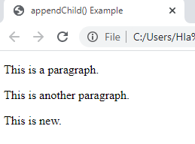
appendChild( )
<div id="div1">
<p id="p1">This is a paragraph.</p>
<p id="p2">This is another paragraph.</p>
</div>
<script type=“text/javascript”>
var para = document.createElement("p");
var node = document.createTextNode("This is new.");
para.appendChild(node);
var element = document.getElementById("div1");
element.appendChild(para);
</script>

Slide 192
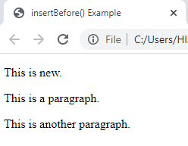
insertBefore( )
<div id="div1">
<p id="p1">This is a paragraph.</p>
<p id="p2">This is another paragraph.</p>
</div>
<script type=“text/javascript”>
var para = document.createElement("p");
var node = document.createTextNode("This is new.");
para.appendChild(node);
var element = document.getElementById("div1");
var child = document.getElementById("p1");
element.insertBefore(para, child);
</script>

Slide 193
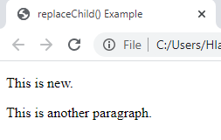
replaceChild( )
<div id="div1">
<p id="p1">This is a paragraph.</p>
<p id="p2">This is another paragraph.</p>
</div>
<script type=“text/javascript”>
var para = document.createElement("p");
var node = document.createTextNode("This is new.");
para.appendChild(node);
var parent = document.getElementById("div1");
var child = document.getElementById("p1");
parent.replaceChild(para, child);
</script>

Slide 194
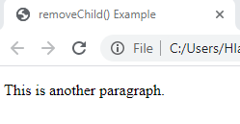
removeChild( )
<div id="div1">
<p id="p1">This is a paragraph.</p>
<p id="p2">This is another paragraph.</p>
</div>
<script type=“text/javascript”>
var parent = document.getElementById("div1");
var child = document.getElementById("p1");
parent.removeChild(child);
</script>

Slide 195
normalize( )
var element = document.createElement("div");
element.className ="message";
var textNode = document.createTextNode("Hello world!");
element.appendChild(textNode);
var anotherTextNode = document.createTextNode("welcome");
element.appendChild(anotherTextNode);
document.body.appendChild(element);
alert(element.childNodes.length); //2
element.normalize();
alert(element.childNodes.length); //1
alert(element.firstChild.nodeValue); //Hello world!welcome

Slide 196
splitText( )
var element = document.createElement("div");
element.className = "message";
var textNode = document.createTextNode("Hello world!");
element.appendChild(textNode);
document.body.appendChild(element);
var newNode = element.firstChild.splitText(5);
alert(element.firstChild.nodeValue); //“Hello"
alert(newNode.nodeValue); //“ world!"
alert(element.childNodes.length); //2

Slide 197
Web Technology JavaScript programming Chapter 10 : The Document Object Model (Working With the DOM)
University of Computer Studies
Department of Information Technology Supporting and Maintenance

Slide 198
Working With the DOM
Dynamic Scripts
Dynamic Styles
DocumentFragment Type
Manipulating Tables

Slide 199
Dynamic Scripts
Dynamic scripts are that don’t exist when the page is loaded but are included later by using the DOM.
As with the HTML element, there are two ways to do this: pulling in an external file or inserting text directly.
Example: (Using DOM)
<!DOCTYPE html>
<html><body>
<h2>External JavaScript</h2>
<p id="demo">A Paragraph.</p>
<button type="button" onclick="myFunction()">Click Me</button>
<script type="text/javascript">
var thescript=document.createElement("script");
thescript.type="text/javascript";
thescript.src="client.js";
document.body.appendChild(thescript);
</script></body></html>

Slide 200
Dynamic Scripts (Cont’d)
Example: (External File – client.js)
function myFunction() {
document.getElementById("demo").innerHTML="Paragraph changed.";}
The external file is not downloaded until the <script> element is added to the page on the last line.
Example: (Using DOM)
<input type="button" value="Add Script" onclick="addScript()">
<script type="text/javascript">
function addScript(){
var script = document.createElement("script");
script.type = "text/javascript";
script.text = "function sayHi(){alert('hi');}";
document.body.appendChild(script);
sayHi();
}</script>

Slide 201
Dynamic Scripts (Cont’d)
Example: (Using DOM –try-catch statement)
<input type="button" value="Add Script" onclick="addScript()">
<script type="text/javascript">
function loadScriptString(code){
var script = document.createElement("script");
script.type = "text/javascript";
try {
script.appendChild(document.createTextNode(code));
} catch (ex){
script.text = code;}
document.body.appendChild(script); }
function addScript(){
loadScriptString("function sayHi(){alert('hi');}");
sayHi(); } </script> </body>

Slide 202
Dynamic Styles
Similar to dynamic scripts, dynamic styles don’t exist on the page when it is loaded initially; rather, they are added after the page has been loaded.
CSS styles are included in HTML pages using one of two elements.
The <link> element is used to include CSS from an external file, the <style> element is used to specify inline styles.
Example: (Using DOM)
<input type="button" value="Add Style" onclick="addStyle()">
<script type="text/javascript">
function addStyle(){
var style = document.createElement("style");
style.type = "text/css";
style.appendChild(document.createTextNode("body{background-color:red}")); //error in IE
var head = document.getElementsByTagName("head")[0];
head.appendChild(style);
} </script>

Slide 203
Dynamic Styles (Cont’d)
Example: (Using DOM –try-catch statement)
<input type="button" value="Add Style" onclick="addStyle()">
<script type="text/javascript">
function loadStyleString(css){
var style = document.createElement("style");
style.type = "text/css";
try{
style.appendChild(document.createTextNode(css));
} catch (ex){
style.styleSheet.cssText = css; }
var head = document.getElementsByTagName("head")[0];
head.appendChild(style);}
function addStyle(){
loadStyleString("body{background-color:red}");
} </script>
Note : added to the <head> instead of the body for properly in all browsers

Slide 204
DocumentFragment Type
The createDocumentFragment() method can also be used to extract parts of a document, change, add, or delete some of the content, and insert it back to the document.
Example:
<body>
<ul id="myList"></ul>
<input type="button" value="Add Items" onclick="addItems()">
<script type="text/javascript">
function addItems(){
var fragment = document.createDocumentFragment();
var ul = document.getElementById("myList");
var li = null;
for (var i=0; i < 3; i++){
li = document.createElement("li");
li.appendChild(document.createTextNode("Item " + (i+1)));
fragment.appendChild(li);
}
ul.appendChild(fragment);
}</script>

Slide 205
Manipulating Tables
Example: (Creating table using DOM)
<button onclick="myFunction()">Try it</button>
<script>
function myFunction() {
var x = document.createElement("TABLE");
x.setAttribute("id", "myTable");
x.border=1;
x.width="30%";
document.body.appendChild(x);
var y = document.createElement("TR");
y.setAttribute("id", "myTr");
document.getElementById("myTable").appendChild(y);
var z = document.createElement("TD");
var t = document.createTextNode("cell");
z.appendChild(t);
document.getElementById("myTr").appendChild(z);
}
</script>

Slide 206
Web Technology JavaScript programming Chapter 11 : DOM Extensions
University of Computer Studies
Department of Information Technology Supporting and Maintenance

Slide 207
SELECTORS API
Selectors API was started by the W3C to specify native support for CSS queries in browsers
One of the most popular capabilities of JavaScript libraries is the ability to retrieve a number of DOM elements matching a pattern specified using CSS selectors.
Two methods are defined: the querySelector() and the querySelectorAll() in the Selectors API Level 1
The matchesSelector() method is introduced in the Selectors API Level 2

Slide 208
The querySelector() method
accepts a CSS query
returns the first descendant element that matches the pattern
returns null if there is no matching element
is available on the Document type and on the Element type
Document type:
Element type:
document . querySelector ( CSS_Selector );
Element . querySelector (CSS_Selector );

Slide 209
The querySelector() method (Cont’d)
<head>
<script type=“text/javascript”src=“querySelect.js”>
</script>
</head>
<body>
<ul>
<li>First item</li>
<li class="selected">Second item</li>
<li>Third item</li>
</ul>
</body>
querySelect.js
if (document.querySelector){
var body = document.querySelector("body");
alert(body.tagName); //BODY
var myDiv = document.querySelector("#myDiv");
alert(myDiv); //null
var selected= document.querySelector(".selected");
alert(selected.innerHTML); //second item
var img = document.body.querySelector("img.button");
alert(img); //null
}

Slide 210
The querySelectorAll() method
accepts a CSS query
returns a NodeList object regardless of the number of matching elements, if there is no matches, the NodeList is empty
is available on the Document, DocumentFragment, and Element types
Document type:
DocumentFragment type:
Element type:
document . querySelectorAll ( CSS_Selector );
DocumentFragment . querySelectorAll ( CSS_Selector );
Element . querySelectorAll ( CSS_Selector );

Slide 211
The querySelectorAll() method (Cont’d)
<html>​
<body>​
<h2>JavaScript HTML DOM!</h2>​
<p>Hello World!</p>​
<p>Hello Norway!</p>​
<p id="demo"></p>​
<script>​
var myNodelist = document.querySelectorAll("p");​
document.getElementById("demo").innerHTML =​"The innerHTML of the second paragraph is: " +​myNodelist[1].innerHTML;​
alert(myNodelist.length);​
</script>
</body>
</html>

Slide 212
The matchesSelector() method
accepts CSS selector
returns true if the given element matches the selector or false if not.
is available on the Element type.
Element type:
Example :
if (document.body.matchesSelector(“body.page1”)){
//To do something
}
Element . matchesSelector ( CSS_Selector );

Slide 213
The matchesSelector() method (Cont’d)
<body class="page1">
<script type="text/javascript">
function matchesSelector(element, selector){
if (element.matchesSelector) {return element.matchesSelector(selector); }
else if (element.msMatchesSelector){ return element.msMatchesSelector(selector);}
else if (element.mozMatchesSelector){ return element.mozMatchesSelector(selector); }
else if (element.webkitMatchesSelector){ return element.webkitMatchesSelector(selector); }
else { throw new Error("Not supported."); }
}
if (matchesSelector(document.body, "body.page1")){
alert("It's page 1!"); }
</script>
</body>

Slide 214
HTML5
HTML5 represents a radical departure from the tradition of HTML.
The HTML5 specification, contains a large amount of JavaScript APIs designed for use with the markup additions.
Because the scope of HTML5 is vast, this lecture focuses only on the parts that affect all DOM nodes

Slide 215
The getElementsByClassName() method
accepts one or more class names as an arguments
returns a NodeList containing all elements that have all of the specified classes applied
is available on the document object and on all HTML elements.
Example:
//get all elements with a class containing “username” and “current”, though it
//doesn’t matter if one is declared before the other
var allCurrentUsernames = document.getElementsByClassName(“username current”);
//get all elements with a class of “selected” that exist in myDiv’s subtree
var selected = document.getElementById(“myDiv”).getElementsByClassName(“selected”);

Slide 216
The classList Property
returns the class name(s) of an element.
is used to add, remove, and replace class names
is an instance of a new type of collection named DOMTokenList
Table 1. Methods of DOMTokenList Collection.
Method | Description
add(value) | Adds the given string value to the list. If the value already exists, it will not be added.
contains(value) | Indicates if the given value exists in the list (true if so; false if not).
remove(value) | Removes the given string value from the list.
toggle(value) | If the value already exists in the list, it is removed. If the value doesn’t exist, then it’s added.

Slide 217
The classList Property (Cont’d)
add(value) method
<html>
<head><style> .mystyle {background-color: blue; color: white;} </style></head>
<body>
<p>Click the button to add the "mystyle" class to DIV.</p>
<button onclick=“myFunction()” >Try it</button>
<div id="myDIV">I am a DIV element</div>
<script>
function myFunction() {
document.getElementById("myDIV") . classList . add("mystyle");
}
</script>
</body></html>

Slide 218
The classList Property (Cont’d)
remove(value) method
<html>
<head><style> .mystyle {background-color: blue;color: white;}</style></head>
<body>
<p>Click the button to add the "mystyle" class to DIV.</p>
<button onclick="myFunction()">Try it</button>
<div id="myDIV" class="mystyle">I am a DIV element</div>
<script>
function myFunction() {
document.getElementById("myDIV").classList.remove("mystyle");
}
</script>
</body>
</html>

Slide 219
The classList Property (Cont’d)
toggle(value) method
<html><head>
<style>
.mystyle {background-color: blue;color: white; width:200px;}
.newClass{background-color:purple:color:blue:width:200px;text-align:center}
</style></head>
<body>
<p>Click the button to add the "mystyle" class to DIV.</p>
<button onclick="myFunction()">Try it</button>
<div id="myDIV" class="mystyle">am a DIV element</div>
<script>
function myFunction() {
document.getElementById("myDIV").classList.toogle(“newClass");
}</script></body></html>

Slide 220
The classList Property (5/5)
contains(value) method
<html><head><style>
.firstClass { width: 500;height: 50px;border: 1px solid black;}
.secondClass { background-color: lightblue;padding: 25px;}
.thirdClass { text-align: center;font-size: 25px;color: pink;margin-bottom: 10px;}
</style></head>
<body>
<div id="myDIV" class="firstClass secondClass thirdClass">I am a DIV element</div>
<button onclick="myFunction()">Try it</button>
<p id="demo"></p>
<script>
function myFunction() {
var x = document.getElementById("myDIV").classList.contains("firstClass");
document.getElementById("demo").innerHTML = x;}</script></body></html>

Slide 221
The innerHTML Property
In read mode, the property returns the HTML representing all of the child nodes.
Example:
<body>
<div id="content">
<p>This is a <strong>paragraph</strong> with a list following it.</p>
<ul>
<li>Item 1</li><li>Item 2</li><li>Item 3</li>
</ul></div>
<input type="button" value="Get InnerHTML" onclick="getInnerHTML()">
<script type="text/javascript">
function getInnerHTML(){
var div = document.getElementById("content");
alert(div.innerHTML); }
</script></body>

Slide 222
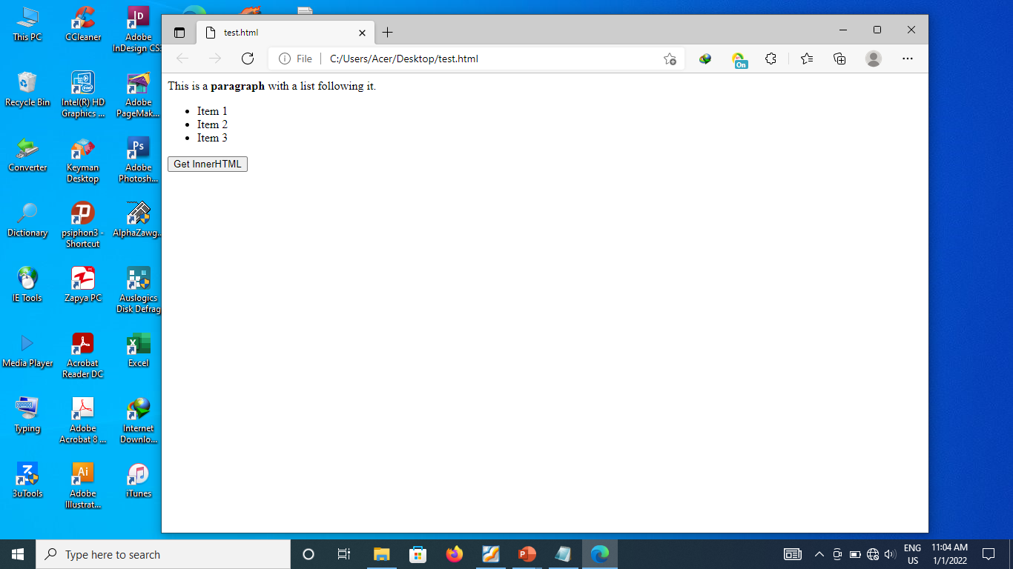
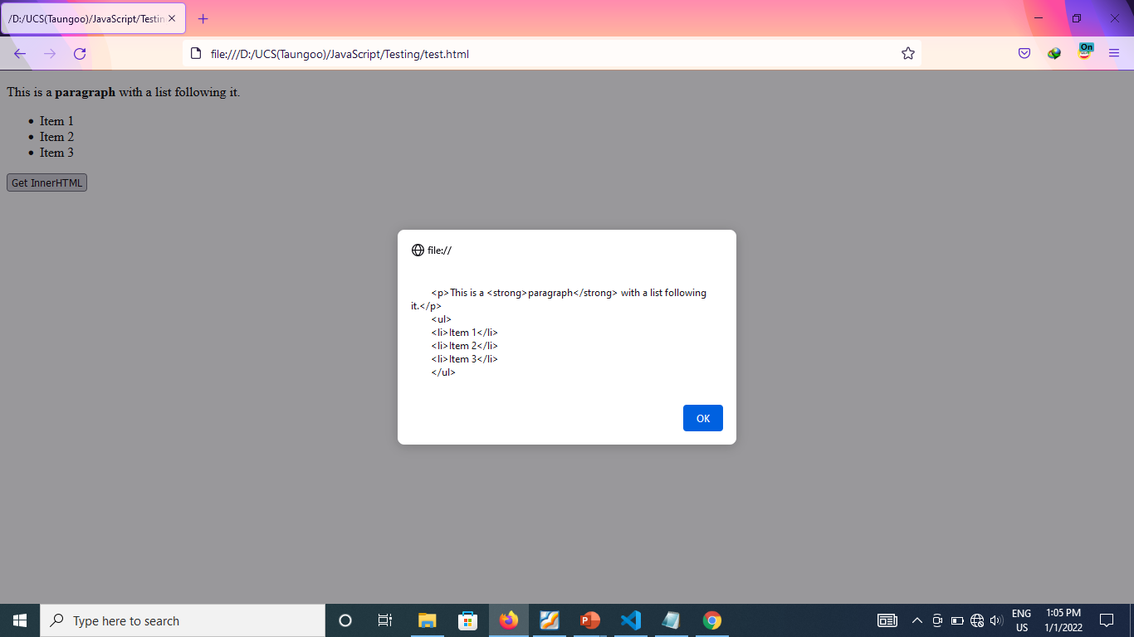
The innerHTML Property (Cont’d)

Slide 223
The innerHTML Property (Cont’d)
In write mode, the property parses the given string into a DOM subtree and replaces all of the existing child nodes with it.
Example:
<body>
<div id="content">
<p>This is a <strong>paragraph</strong> with a list following it.</p>
<ul> <li>Item 1</li> <li>Item 2</li> <li>Item 3</li> </ul>
</div>
<input type="button" value="Set InnerHTML" onclick="setInnerHTML()">
<script type="text/javascript">
function setInnerHTML(){
var div = document.getElementById("content");
div.innerHTML = "Hello & welcome, <b>\"reader\"!</b>";
} </script> </body>

Slide 224
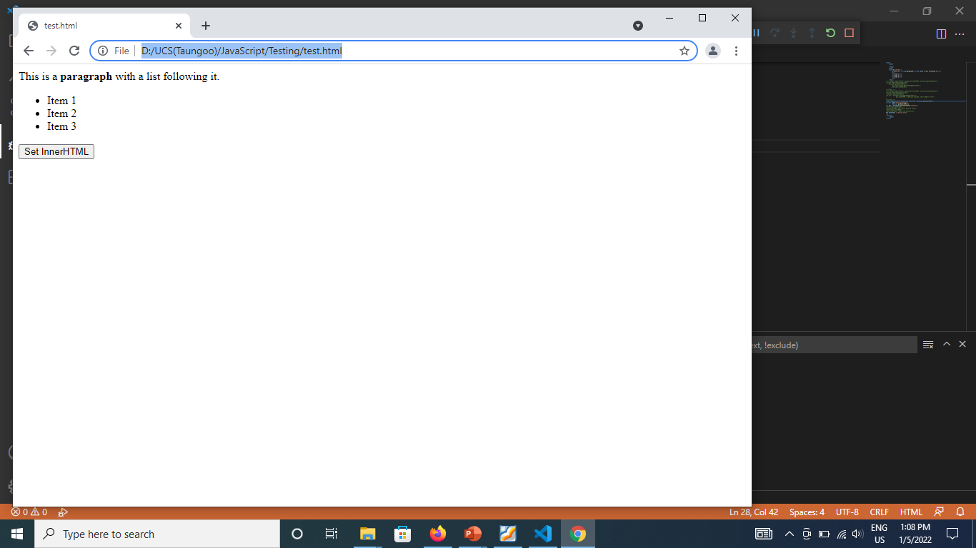
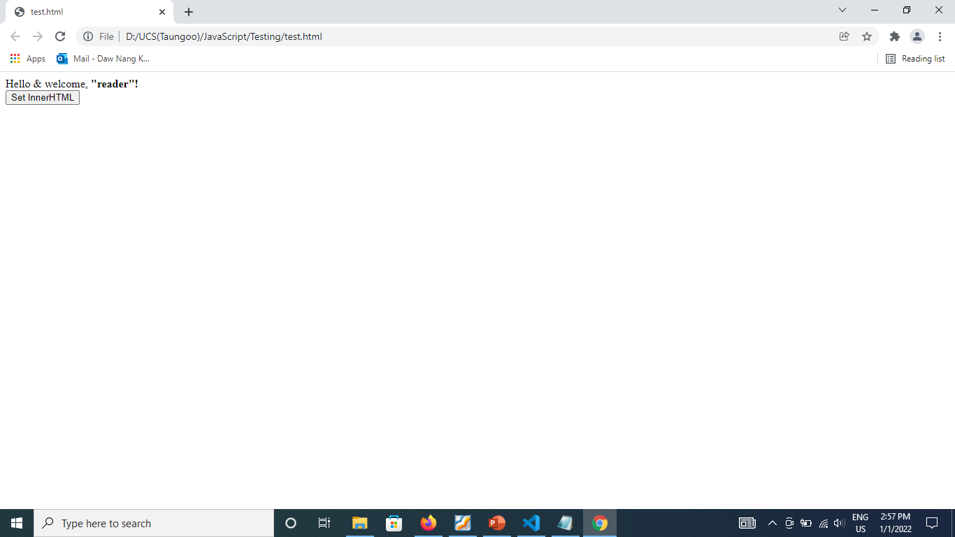
The innerHTML Property (Cont’d)

Slide 225
The outerHTML Property
In read mode, the property returns the HTML of element on which it is called as well as its child nodes.
Example:
<body>
<div id="content">
<p>This is a <strong>paragraph</strong> with a list following it.</p>
<ul> <li>Item 1</li> <li>Item 2</li> <li>Item 3</li> </ul>
</div>
<input type="button" value="Get OuterHtml" onclick="getOuterHTML()">
<script type="text/javascript">
function getOuterHTML(){
var div = document.getElementById("content");
alert(div.outerHTML); //works in IE, Safari, and Opera
} </script></body>

Slide 226
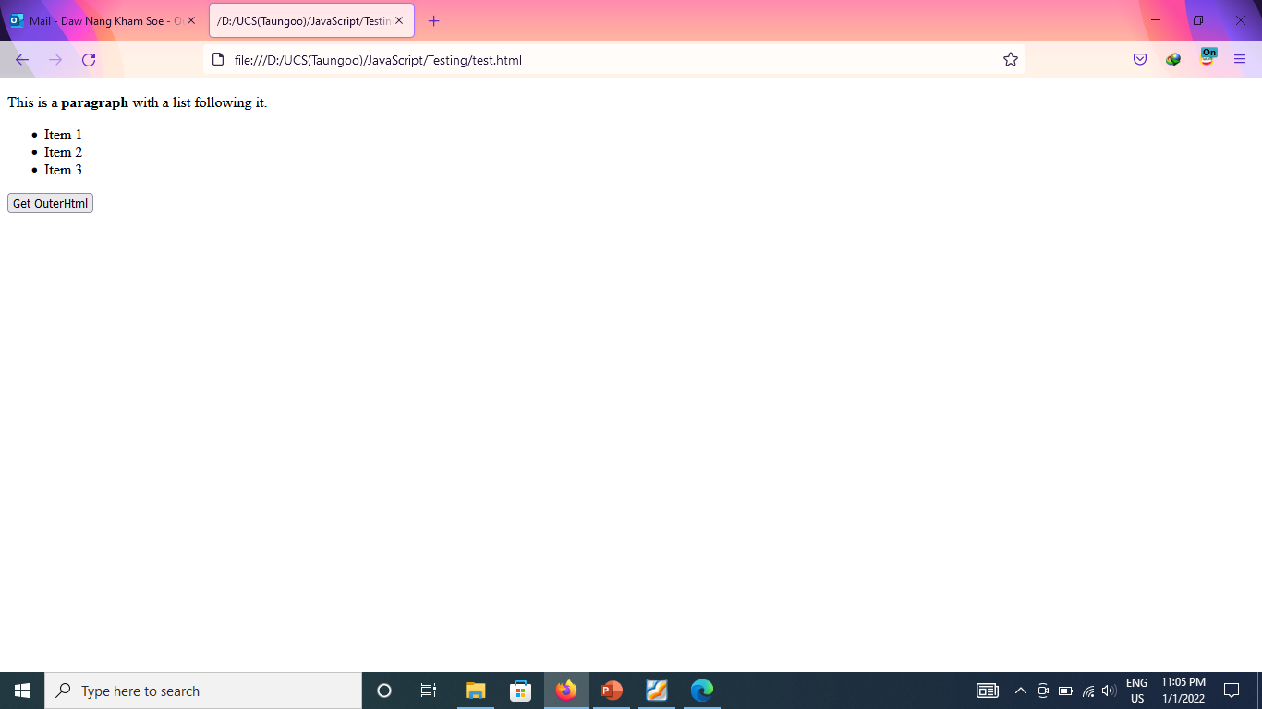
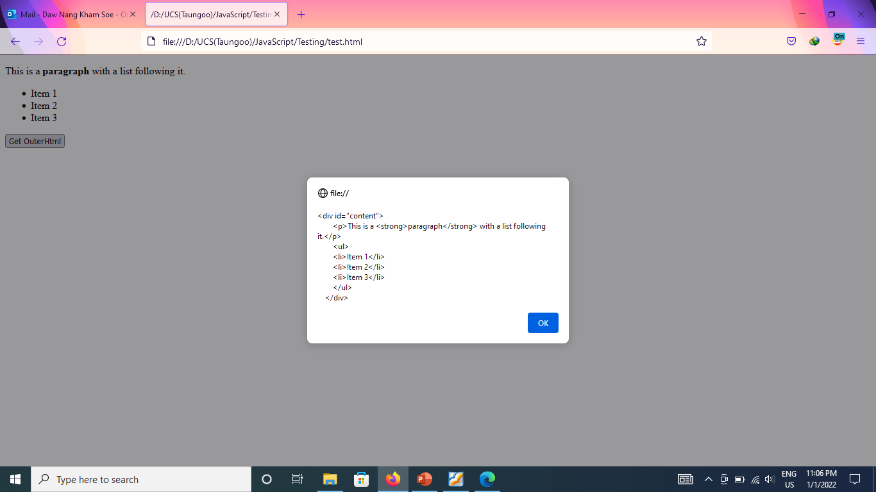
The outerHTML Property (Cont’d)

Slide 227
The outerHTML Property (Cont’d)
In write mode, the property replaces the node on which it called with the DOM subtree created from passing the given HTML string.
Example:
div.outerHTML=”<h1> Hello & World </h1>” //Hello & World

Slide 228
The innerText Property
In read mode, the property concatenates the values of all text nodes in the subtree in depth-first order.
Example:
<body>
<div id="content">
<p>This is a <strong>paragraph</strong> with a list following it.</p>
<ul>
<li>Item 1</li><li>Item 2</li><li>Item 3</li>
</ul></div>
<input type="button" value="Get InnerText" onclick="getInnerText()">
<script type="text/javascript">
function getInnerText(){
var div = document.getElementById("content");
alert(div.innerText); }
</script></body>

Slide 229
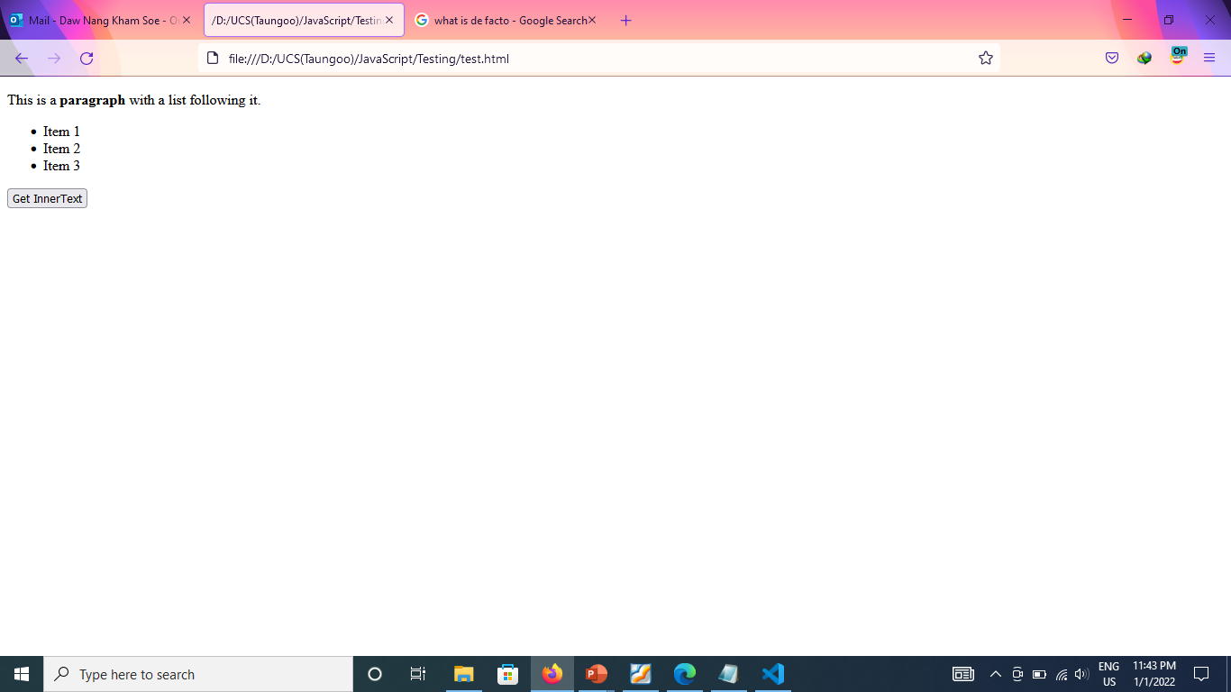
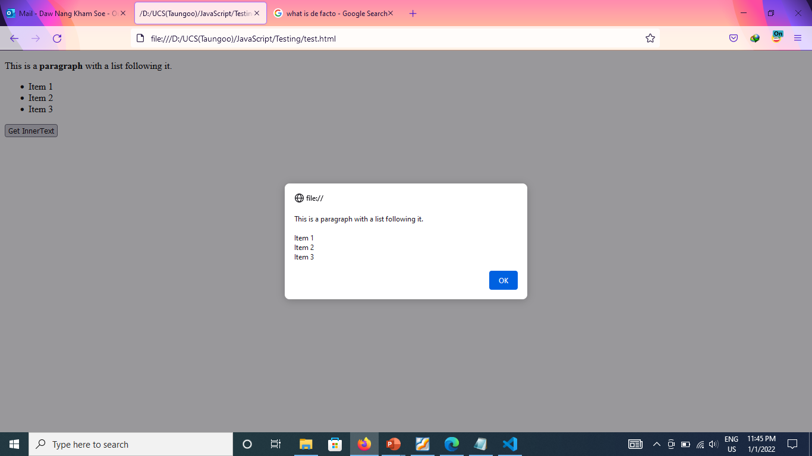
The innerText Property (Cont’d)

Slide 230
The innerText Property (Cont’d)
In write mode, the property removes all children of the element and inserts a text nodes containing the given value.
Example:
<body>
<div id="content">
<p>This is a <strong>paragraph</strong> with a list following it.</p>
<ul> <li>Item 1</li> <li>Item 2</li> <li>Item 3</li> </ul>
</div>
<input type="button" value="Set InnerText" onclick="setInnerText()">
<script type="text/javascript">
function setInnerText(){
var div = document.getElementById("content");
div.innerText= "Hello <b> world!</b>";
} </script> </body>

Slide 231
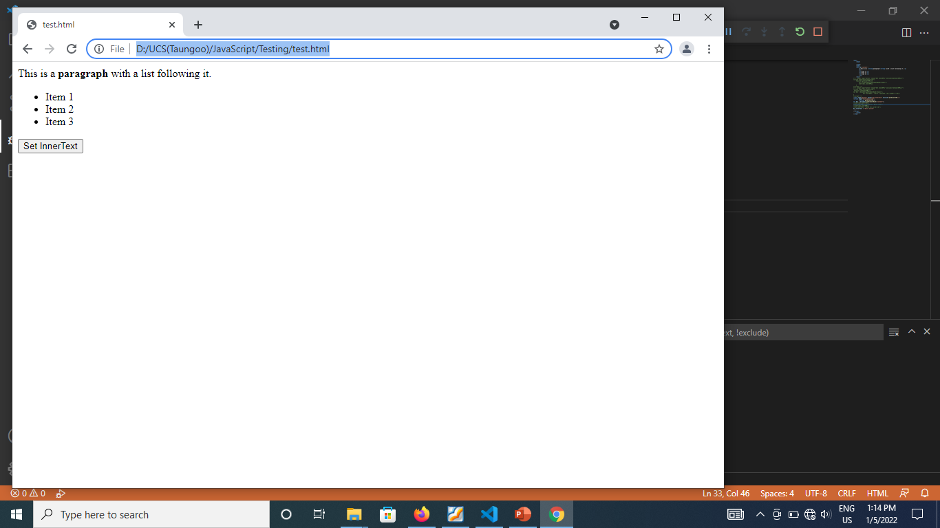
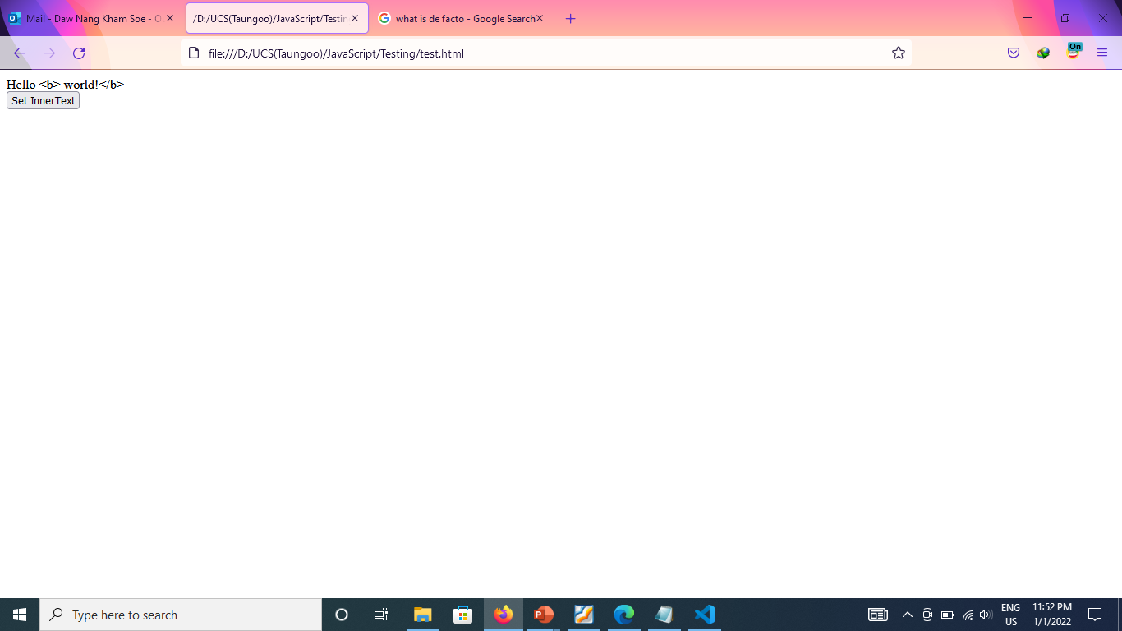
The innerText Property (Cont’d)

Slide 232
The outerText Property
In read mode, the property behave in the exact same way as innerText property
Example:
<body>
<div id="content">
<p>This is a <strong>paragraph</strong> with a list following it.</p>
<ul>
<li>Item 1</li><li>Item 2</li><li>Item 3</li>
</ul></div>
<input type="button" value="Get outerText" onclick="getOuterText()">
<script type="text/javascript">
function getOuterText(){
var div = document.getElementById("content");
alert(div.outerText); }
</script></body>

Slide 233
The outerText Property (Cont’d)
In write mode, the property replaces the entire element, including its child nodes.
Example:
<body>
<div id="content">
<p>This is a <strong>paragraph</strong> with a list following it.</p>
<ul> <li>Item 1</li> <li>Item 2</li> <li>Item 3</li> </ul>
</div>
<input type="button" value="Set outerText" onclick=“setOuterText()">
<script type="text/javascript">
function setOuterText(){
var div = document.getElementById("content");
div.outerText = "Hello world!";}
</script> </body>

Slide 234
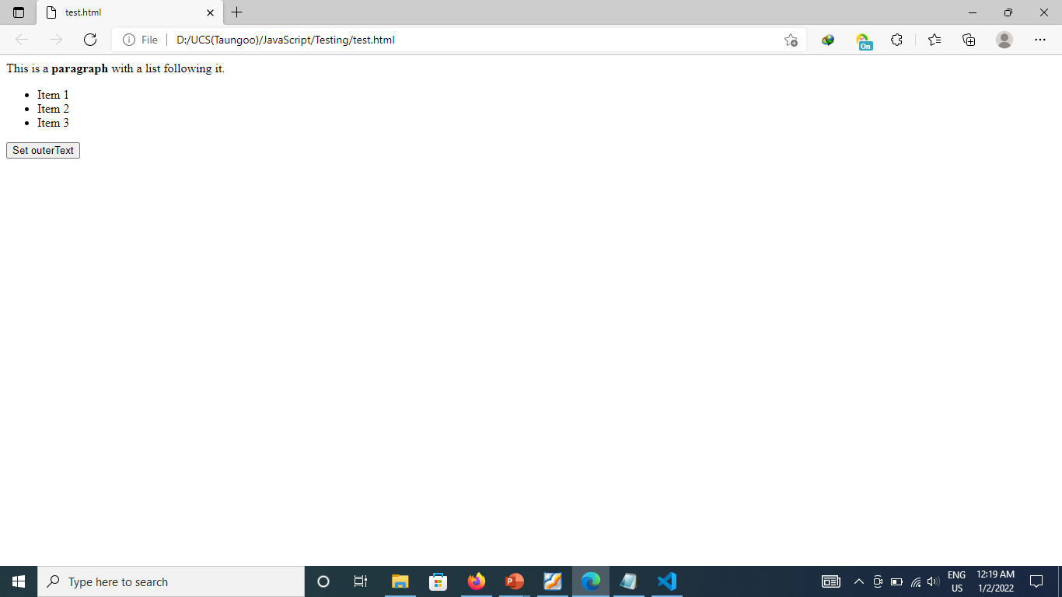

The outerText Property (Cont’d)

Slide 235
The insertAdjacentHTML() Method
inserts a text as HTML into a specified position.
accepts two arguments: (the position in which to insert, the HTML text to insert)
The ﬁrst argument must be one of the following values:
“beforebegin”— Insert just before the element as a previous sibling.
“afterbegin”— Insert just inside of the element as a new child or series of children before the first child.
“beforeend”— Insert just inside of the element as a new child or series of children after the last child.
“afterend”— Insert just after the element as a next sibling.

Slide 236
The insertAdjacentHTML() Method (Cont’d)
//insert as previous sibling
element.insertAdjacentHTML(“beforebegin”, “<p>Hello world!</p>”);
//insert as first child
element.insertAdjacentHTML(“afterbegin”, “<p>Hello world!</p>”);
//insert as last child
element.insertAdjacentHTML(“beforeend”, “<p>Hello world!</p>”);
//insert as next sibling
element.insertAdjacentHTML(“afterend”, “<p>Hello world!</p>”);

Slide 237
Web Technology JavaScript Programming Events
University of Computer Studies
Department of Information Technology Supporting and Maintenance

Slide 238
Events
JavaScript’s interaction with HTML is handled through events.
Events occur when the user or the browser manipulates a page.
When the page loads, it is called an event. When the user clicks a button, that click too is an event. Other examples include events like pressing any key, closing a window, resizing a window, etc.
238

Slide 239
Event Flow
Event flow describes the order in which events are received on the page.
239

Slide 240
Event Bubbling
An event is said to start at the innermost element (the deepest in the document tree) and then flow upward toward the outer node (the document).
<!DOCTYPE html>
<html>
<head>
<title>Event Bubbling Example</title>
</head>
<body>
<div id=“myDiv”>Click Me</div>
</body>
</html>
When you click the <div> element in the page, the click event occurs in the following order:
1. <div>
2. <body>
3. <html>
4. document
240

Slide 241
Event Capturing
The theory of event capturing is that the outermost node should receive the event first and the innermost element should receive the event last.
If the previous example is used with event capturing, clicking the <div> element fires the click event in the following order:
1. document
2. <html>
3. <body>
4. <div>
241

Slide 242

DOM Event Flow
The event flow specified by DOM Level 2 Events has three phases: the event capturing phase, at the target, and the event bubbling phase.
Event capturing occurs first, providing the opportunity to intercept events if necessary. Next, the actual target receives the event. The final phase is bubbling, which allows a final response to the event.
242

Slide 243
Event Handlers
Events are certain actions performed either by the user or by the browser itself.
Events have names like click, load, and mouseover.
A function that is called in response to an event is called an event handler (or an event listener).
Event handlers have names beginning with “on”, so an event handler for the click event is called onclick and an event handler for the load event is called onload.
Assigning event handlers can be accomplished in a number of different ways.
243

Slide 244
HTML Event Handlers
Each event supported by a particular element can be assigned using an HTML attribute with the name of the event handler.
The value of the attribute should be some JavaScript code to execute.
To execute some JavaScript when a button is clicked:
<input type=“button” value=“Click Me” onclick=“alert(‘Clicked’)” />
Since the JavaScript code is an attribute value, you cannot use HTML syntax characters without escaping them.
To use double quotes:
<input type=“button” value=“Click Me” onclick=“alert(&quot;Clicked&quot;)” />
244

Slide 245
HTML Event Handlers (cont’d)
<!DOCTYPE html>
<html>
<head>
<title>HTML Event Handler Example</title>
</head>
<body>
<input type="button" value="Click Me" onclick="alert('Clicked')" />
<input type="button" value="Click Me" onclick="showMessage()" />
<script type="text/javascript">
function showMessage(){
alert("Hello world!");
}
</script>
</body>
</html>
245

Slide 246
DOM Level 0 Event Handlers
The traditional way of assigning event handlers is to assign a function to an event handler property.
var btn = document.getElementById(“myBtn”);
btn.onclick = function(){
alert(“Clicked”);
};
When assigning event handlers using the DOM Level 0 method, the event handler is considered to be a method of the element.. The event handler is run within the scope of element, meaning that this is equivalent to the element.
var btn = document.getElementById(“myBtn”);
btn.onclick = function(){
alert(this.id); //“myBtn”
};
Can remove an event handler by setting the value of the event handler property to null.
btn.onclick = null; //remove event handler
246

Slide 247
DOM Level 0 Event Handlers (cont’d)
<body>
<input type="button" id="myBtn" value="Click Me" />
<input type="button" id="myRemoveBtn" value="Remove Event Handler" />
<script type="text/javascript">
var btn = document.getElementById("myBtn");
btn.onclick = function(){
alert(this.id);
};
var removeBtn = document.getElementById("myRemoveBtn");
removeBtn.onclick = function(){
btn.onclick = null;
};
</script>
</body>
247

Slide 248
DOM Level 2 Event Handlers
DOM Level 2 Events define two methods:
addEventListener() — assignment of event handlers
removeEventListener() — removal of event handlers
These methods accept three arguments: the event name to handle, the event handler function, and a Boolean value indicating whether to call the event handler during the capture phase (true) or during the bubble phase (false).
The major advantage to using the DOM Level 2 method for adding event handlers is that multiple event handlers can be added.
Event handlers added via addEventListener() can be removed only by using removeEventListener() and passing in the same arguments as were used when the handler was added.
248

Slide 249
DOM Level 2 Event Handlers (cont’d)
<body>
<input type="button" id="myBtn" value="Click Me" />
<script type="text/javascript">
var btn = document.getElementById("myBtn");
btn.addEventListener("click", function(){
alert(this.id);
}, false);
btn.addEventListener("click", function(){
alert("Hello world!");
}, false);
</script>
</body>
249

Slide 250
DOM Level 2 Event Handlers (cont’d)
<body>
<input type="button" id="myBtn" value="Click Me" />
<input type="button" id="myRemoveBtn" value="Remove Event Handler" />
<script type="text/javascript">
var btn = document.getElementById("myBtn");
var handler = function(){
alert(this.id);
};
btn.addEventListener("click", handler, false);
var removeBtn = document.getElementById("myRemoveBtn");
removeBtn.onclick = function(){
btn.removeEventListener("click", handler, false); //works!
};
</script>
</body>
250

Slide 251
Internet Explorer Event Handlers
Internet Explorer implements methods called attachEvent() and detachEvent().
These methods accept two arguments: the event handler name and the event handler function.
When using attachEvent(), the event handler runs in the global context, so this is equivalent to window.
The attachEvent() method can be used to add multiple event handlers to a single element.
Events added using attachEvent() are removed using detachEvent() as long as the same arguments are provided.
251

Slide 252
Internet Explorer Event Handlers (cont’d)
<body>
<input type="button" id="myBtn" value="Click Me" />
<p>This example works only in Internet Explorer.</p>
<script type="text/javascript">
var btn = document.getElementById("myBtn");
btn.attachEvent("onclick", function(){
alert("Clicked");
});
btn.attachEvent("onclick", function(){
alert("Hello world!");
});
</script>
</body>
252

Slide 253
Internet Explorer Event Handlers (cont’d)
<body>
<input type="button" id="myBtn" value="Click Me" />
<input type="button" id="myRemoveBtn" value="Remove Event Handler" />
<script type="text/javascript">
var btn = document.getElementById("myBtn");
var handler = function(){
alert("Clicked");
};
btn.attachEvent("onclick", handler);
var removeBtn = document.getElementById("myRemoveBtn");
removeBtn.onclick = function(){
btn.detachEvent("onclick", handler);
};
</script>
</body>
253

Slide 254
Cross-Browser Event Handlers
The addHandler() method
The method’s job is to use the DOM Level 0 approach, the DOM Level 2 approach, or the Internet Explorer approach to adding events, depending on which is available.
This method is attached to an object called EventUtil.
The method accepts three arguments: the element to act on, the name of the event, and the event handler function.
The removeHandler() method
The method accepts the same three arguments as the addHandler() method.
This method’s job is to remove a previously added event handler using whichever means is available, defaulting to DOM Level 0 if no other method is available.
254

Slide 255
Cross-Browser Event Handlers (cont’d)
<body>
<input type="button" id="myBtn" value="Click Me" />
<input type="button" id="myRemoveBtn" value="Remove Event Handler" />
<script type="text/javascript">
var btn = document.getElementById("myBtn");
var handler = function(){
alert("Clicked");
};
EventUtil.addHandler(btn, "click", handler);
var removeBtn = document.getElementById("myRemoveBtn");
EventUtil.addHandler(removeBtn, "click", function(){
EventUtil.removeHandler(btn, "click", handler);
});
</script>
</body>
255

Slide 256
The Event Object
When an event related to the DOM is fired, all of the relevant information is gathered and stored on an object called event.
Event object contains basic information such as the element that caused the event, the type of event that occurred, and any other data that may be relevant to the particular event.
For example,
an event caused by a mouse action generates information about the mouse’s position.
an event caused by a keyboard action generates information about the keys that were pressed.
All browsers support the event object, though not in the same way.
256

Slide 257
The DOM Event Object
The event object is passed in as the sole argument to an event handler regardless of the method used to assign the event handler, DOM Level 0 or DOM Level 2.
var btn = document.getElementById(“myBtn”);
btn.onclick = function(event){
alert(event.type); //“click”
};
btn.addEventListener(“click”, function(event){
alert(event.type); //“click”
}, false);
When an event handler is assigned using HTML attributes, the event object is available as a variable called event.
<input type=“button” value=“Click Me” onclick=“alert(event.type)”>
257

Slide 258
The Internet Explorer Event Object
When an event handler is assigned using the DOM Level 0 approach, the event object exists only as a property of the window object.
var btn = document.getElementById(“myBtn”);
btn.onclick = function(){
var event = window.event;
alert(event.type); //“click”
};
If the event handler is assigned using attachEvent(), the event object is passed in as the sole argument to the function.
var btn = document.getElementById(“myBtn”);
btn.attachEvent(“onclick”, function(event){
alert(event.type); //“click”
});
If the event handler is assigned by an HTML attribute, the event object is available as a variable called event.
<input type=“button” value=“Click Me” onclick=“alert(event.type)”>
258

Slide 259
The Cross-Browser Event Object
Although the event objects for the DOM and Internet Explorer are different, there are enough similarities to allow cross-browser solutions.
The EventUtil object can be augmented with methods that equalize the differences.
There are four new methods added to EventUtil.
The first is getEvent(), which returns a reference to the event object.
The second method is getTarget(), which returns the target of the event.
The third method is preventDefault(), which stops the default behavior of an event.
The fourth method, stopPropagation(), which stops the event flow.
259

Slide 260
Event Types
There are numerous categories of events that can occur in a web browser. DOM Level 3 Events specifies the following event groups:
User interface (UI) events are general browser events that may have some interaction with the BOM.
Focus events are fired when an element gains or loses focus.
Mouse events are fired when the mouse is used to perform an action on the page.
Wheel events are fired when a mouse wheel (or similar device) is used.
Text events are fired when text is input into the document.
Keyboard events are fired when the keyboard is used to perform an action on the page.
Composition events are fired when inputting characters for an Input Method Editor (IME).
Mutation events are fired when a change occurs to the underlying DOM structure.
Mutation name events are fired when element or attribute names are changed.
260

Slide 261
UI Events
UI events aren’t necessarily related to user actions.
The onload event handler — when the entire page has been loaded.
The onunload event handler — when a document has completely unloaded.
The onresize event handler — when the browser window is resized to a new height or width.
The onerror event handler — when any error occurs on a window object.
261

Slide 262
Input Events
The onblur event handler — when an item comes out of focus on a web page.
For example, if you click on a text field and then click on something else in the page, the text field was on focus when you clicked it, but came out of focus when you clicked something else on the page.
The onchange event handler — when a user changes something within a form element.
For example, when a user selects a new option from a list of drop-down selection menu.
262

Slide 263
Mouse Events
The onmouseup event handler — when the mouse button is released over an element.
The mousedown event handler — when the mouse button is pressed over an element.
The mousemove event handler — when the mouse button moves over an element.
The mouseover event handler — when the mouse cursor/pointer moves onto the element.
The mouseout event handler — when the mouse cursor/pointer moves out of an element.
263

Slide 264
Click Events
The onclick event handler — when the user clicks on an HTML element. It allows the execution of the JavaScript function.
The ondblclick event handler — when the user double-clicks on an HTML element.
264

Slide 265
Web Technology JavaScript Programming Scripting Forms
University of Computer Studies
Department of Information Technology Supporting and Maintenance

Slide 266
Form Basics
Web forms are represented by the <form> element in HTML and by the HTMLFormElement type in JavaScript.
The HTMLFormElement has the following properties and methods:
acceptCharset — The character sets that the server can process.
action — The URL to send the request to.
elements — An HTMLCollection of all controls in the form.
enctype — The encoding type of the request.
length — The number of controls in the form.
method — The type of HTTP request to send, typically “get” or “post”.
name — The name of the form.
reset() — Resets all form fields to their default values.
submit() — Submits the form.
target — The name of the window to use for sending the request and receiving the response.
266

Slide 267
Accessing Forms
References to <form> elements can be retrieved by the use of getElementById():
var form = document.getElementById(“form1”);
All forms on the page can be retrieved from document.forms collection.
Each form can be accessed in this collection by numeric index and by name:
var firstForm = document.forms[0]; //get the first form in the page
var myForm = document.forms[“form2”]; //get the form with a name of “form2”
Forms can have both an id and a name and that these values need not be the same.
267

Slide 268
Submitting Forms
Forms are submitted when a user interacts with a submit button or an image button.
<!-- generic submit button -->
<input type=“submit” value=“Submit Form”>
<!-- custom submit button -->
<button type=“submit”>Submit Form</button>
<!-- image button -->
<input type=“image” src=“graphic.gif”>
The submit() method can be called at any time to submit a form via JavaScript and does not require a submit button to be present in the form to function appropriately.
var form = document.getElementById(“myForm”);
//submit the form
form.submit();
268

Slide 269
Resetting Forms
Forms are reset when the user clicks a reset button.
<!-- generic reset button -->
<input type=“reset” value=“Reset Form”>
<!-- custom reset button -->
<button type=“reset”>Reset Form</button>
When a form is reset, all of the form fields are set back to the values they had when the page was first rendered.
Resetting a form can be accomplished via JavaScript using the reset() method.
var form = document.getElementById(“myForm”);
//reset the form
form.reset();
269

Slide 270
Form Fields
Form elements can be accessed using native DOM methods.
All form elements are parts of an elements collection that is a property of each form.
The elements collection is an ordered list of references to all form fields in the form and includes all form elements.
Each form field appears in the elements collection in the order in which it appears in the markup, indexed by both position and name.
If a name is in use by multiple form controls, then an HTMLCollection is returned containing all of the elements with the name.
Form elements include <input>, <label>, <textarea>, <button>, <select>, <fieldset>, and <legend> elements.
270

Slide 271
Input Element’s Types
<input type=“button”>
<input type=“checkbox”>
<input type=“color”>
<input type=“date”>
<input type=“datetime-local”>
<input type=“email”>
<input type=“file”>
<input type=“hidden”>
<input type=“image”>
<input type=“month”>
<input type=“number”>
<input type=“password”>
<input type=“radio”>
<input type=“range”>
<input type=“reset”>
<input type=“search”>
<input type=“submit”>
<input type=“tel”>
<input type=“text”>
<input type=“time”>
<input type=“url”>
<input type=“week”>
271

Slide 272

Form Fields Example
<form method="post" action="javascript:alert('Form submitted!')" id="myForm">
<ul>
<li><input type="radio" name="color" value="red">Red</li>
<li><input type="radio" name="color" value="green">Green</li>
<li><input type="radio" name="color" value="blue">Blue</li>
</ul>
</form>
<script type="text/javascript">
(function(){
var form = document.getElementById("myForm");
var colorFields = form.elements["color"];
alert(colorFields.length); //3
var firstColorField = colorFields[0];
var firstFormField = form.elements[0];
alert(firstColorField === firstFormField); //true
})();
</script>
272

Slide 273
Common Form-Field Properties
The common form-field properties are:
disabled — A Boolean indicating if the field is disabled.
form — A pointer to the form that the field belongs to. This property is read only.
name — The name of the field.
readOnly — A Boolean indicating if the field is read only.
tabIndex — Indicates the tab order for the field.
type — The type of the field: “checkbox”, “radio”, and so on.
value — The value of the field that will be submitted to the server. For file-input fields, this property is read only and simply contains the file’s path on the computer.
273

Slide 274
Common Form-Field Methods
Each form field has two methods:
The focus() method sets the browser’s focus to the form field, meaning that the field becomes active and will respond to keyboard events.
The blur() method removes focus from the element.
274

Slide 275

Focus Example
<p>The textbox will receive focus as soon as the page loads.</p>
<form method="post" action="javascript:alert('Form submitted!')" id="myForm">
<div>
<label for="comments">Any comments?</label><br>
<textarea rows="10" cols="50" id="comments" name="comments" autofocus></textarea>
</div>
<input type="submit" value="Submit Form" id="submit-btn">
</form>
<script type="text/javascript">
var element = document.forms[0].elements[0];
if (element.autofocus !== true){
element.focus();
alert("JS focus");
}
else { alert("HTML focus"); }
</script>
275

Slide 276
Common Form-Field Events
All form fields support the following three events in addition to mouse, keyboard, mutation, and HTML events:
blur — Fires when the field loses focus.
change — Fires when the field loses focus and the value has changed for <input> and <textarea> elements; also fires when the selected option changes for <select> elements.
focus — Fires when the field gets focus.
276

Slide 277
Scripting Text Boxes
There are two ways to represent text boxes in HTML:
a single-line version using the <input> element
<input type=“text” size=“25” maxlength=“50” value=“initial value”>
a multiline version using the <textarea> element
<textarea rows=“25” cols=“5”>initial value</textarea>
<form>
<input type="text" value="Enter Name" id="text-btn">
</form>
<script type="text/javascript">
var txtbox = document.forms[0].elements[0];
alert(txtbox.value);
txtbox.value = "Some Other Name";
</script>
277

Slide 278
Text Selection
Both types of text boxes support a method called select(), which selects all of the text in a text box.
The method accepts no arguments and can be called at any time.
<form>
<input type="text" value="Enter Name" id="text-btn">
</form>
<script type="text/javascript">
var textbox = document.forms[0].elements[0];
textbox.onfocus = function(event){
var text = event.target;
text.select();
text.focus();
};
</script>
278

Slide 279
Retrieving Selected Text
To get the selected text in a text box, use the selectionStart and selectionEnd properties indicating the text-selection boundaries (the offset of the beginning of text selection and the offset of end of text selection, respectively).
function getSelectedText(textbox){
return textbox.value.substring(textbox.selectionStart, textbox.selectionEnd);
}
Since the substring() method works on string offsets, the values from selectionStart and selectionEnd can be passed in directly to retrieve the selected text.
279

Slide 280
Partial Text Selection
The setSelectionRange() method takes two arguments: the index of the first character to select and the index at which to stop the selection.
<form>
<input type="text" value="Hello world!"/>
</form>
<script type="text/javascript">
var textbox = document.forms[0].elements[0];
textbox.onfocus = function(event){
//select all text
textbox.setSelectionRange(0, textbox.value.length); //"Hello world!"
//select first three characters
textbox.setSelectionRange(0, 3); //"Hel"
//select characters 4 through 6
textbox.setSelectionRange(4, 7); //"o w"
};
</script>
280

Slide 281
Partial Text Selection (cont’d)
The selectText() function accepts three arguments: the text box to act on, the index at which to begin the selection, and the index before which to end the selection.
<form>
<input type="text" value="Hello world!"/>
</form>
<script type="text/javascript">
var textbox = document.forms[0].elements[0];
textbox.onfocus = function(event){
//select all text
selectText(textbox, 0, textbox.value.length); //"Hello world!"
//select first three characters
selectText(textbox, 0, 3); //"Hel"
//select characters 4 through 6
selectText(textbox, 4, 7); //"o w"
};
function selectText(textbox, startIndex, stopIndex){
if (textbox.setSelectionRange){
textbox.setSelectionRange(startIndex, stopIndex);
} else if (textbox.createTextRange){
var range = textbox.createTextRange();
range.collapse(true);
range.moveStart("character", startIndex);
range.moveEnd("character", stopIndex - startIndex);
range.select();
}
textbox.focus();
}
</script>
281

Slide 282
Required Fields
Any field marked as required must have a value in order for the form to be submitted.
This attribute applies to <input>, <textarea>, and <select> fields.
<input type=“text” name=“username” required>
Check to see if a form field is required in JavaScript by using the corresponding required property on the element:
var isUsernameRequired = document.forms[0].elements[“username”].required;
Test to see if the browser supports the required attribute:
var isRequiredSupported = “required” in document.createElement(“input”);
282

Slide 283
Required Fields Example
<body>
<p>Try submitting the form without filling in a value for the textbox.</p>
<script>
function myFunction() {
var x = document.getElementById("username").required; document.getElementById("demo").innerHTML = x;
}
</script>
<form method="post" action="javascript:alert('Form submitted!')" id="myForm">
<label for="username">Username:</label>
<input type="text" name="username" id="username" required>
<input type="submit" value="Submit Form">
<button onclick="myFunction()">Try it</button>
<p id="demo"></p>
</form>
</body>
283

Slide 284
Input Patterns
The pattern attribute was introduced for text fields in HTML5.
This attribute specifies a regular expression with which the input value must match.
To allow only numbers in a text field:
<input type=“text” pattern=“\d+” name=“count”>
The pattern is applied to the value, and the browser then knows if the value is valid or not.
Read the pattern by accessing the pattern property:
var pattern = document.forms[0].elements[“count”].pattern;
Test to see if the browser supports the pattern attribute:
var isPatternSupported = “pattern” in document.createElement(“input”);
284

Slide 285
Scripting Select Boxes
Select boxes are created using the <select> and <option> elements.
Consider the following select box:
<select name=“location” id=“selLocation”>
<option value=“Sunnyvale, CA”>Sunnyvale</option>
<option value=“Los Angeles, CA”>Los Angeles</option>
<option value=“Mountain View, CA”>Mountain View</option>
<option value=“”>China</option>
<option>Australia</option>
</select>
To get the text and value of the first option in the select box:
var selectbox = document.forms[0].elements[“location”];
var text = selectbox.options[0].text; //option text
var value = selectbox.options[0].value; //option value
285

Slide 286
Options Selection
For a select box that allows only one option to be selected
To retrieve the option:
var selectedOption = selectbox.options[selectbox.selectedIndex];
To display all of the information about the selected option:
var selectedIndex = selectbox.selectedIndex;
var selectedOption = selectbox.options[selectedIndex];
alert(“Selected index: ” + selectedIndex + “\nSelected text: ” + selectedOption.text + “\nSelected value: ” + selectedOption.value);
When used in a select box that allows multiple selections
To select the first option in a select box:
selectbox.options[0].selected = true;
286

Slide 287
Options Selection Example
<form method="post" action="javascript:alert('Form submitted!')" id="myForm">
<div>
<label for="selLocation">Where do you want to live?</label>
<select name="location" id="selLocation">
<option value="Sunnyvale, CA">Sunnyvale</option>
<option value="Los Angeles, CA">Los Angeles</option>
<option value="Mountain View, CA">Mountain View</option>
<option value="">China</option>
<option>Australia</option>
</select>
</div>
<div>
<input type="button" value="Select first option" id="btnFirst" />
<input type="button" value="Select second option" id="btnSecond" />
<input type="button" value="Get selected option" id="btnSelected" />
</div>
</form>
287

Slide 288
Options Selection Example (cont’d)
<script type="text/javascript">
(function(){
var btn1 = document.getElementById("btnFirst"); var btn2 = document.getElementById("btnSecond");
var btn3 = document.getElementById("btnSelected");
var selectbox = document.getElementById("selLocation");
EventUtil.addHandler(btn1, "click", function(event){
selectbox.selectedIndex = 0; //(OR) selectbox.options[0].selected = true;
});
EventUtil.addHandler(btn2, "click", function(event){
selectbox.selectedIndex = 1; //(OR) selectbox.options[1].selected = true;
});
EventUtil.addHandler(btn3, "click", function(event){
var selIndex = selectbox.selectedIndex;
var selOption = selectbox.options[selIndex];
alert("Selected index: " + selectbox.selectedIndex + "\nSelected text: " + selOption.text + "\nSelected value: " + selOption.value); });
})();
</script>
288

Slide 289
Adding Options
Several ways to create options dynamically and add them to select boxes using JavaScript.
Using the DOM
var newOption = document.createElement(“option”);
newOption.appendChild(document.createTextNode(“Option text”));
newOption.setAttribute(“value”, “Option value”);
selectbox.appendChild(newOption);
Using the Option constructor — Accepts two arguments: the text and the value.
var newOption = new Option(“Option text”, “Option value”);
selectbox.appendChild(newOption);
Using the select box’s add() method — Accepts two arguments: the new option to add and the option before which the new option should be inserted.
var newOption = new Option(“Option text”, “Option value”);
selectbox.add(newOption, undefined); //the option is added at the end of the list
289

Slide 290
Removing Options
Multiple ways to remove options.
Using the DOM removeChild() method
selectbox.removeChild(selectbox.options[0]); //remove first option
Using the select box’s remove() method — Accepts a single argument: the index of the option to remove.
selectbox.remove(0); //remove first option
Set the option equal to null
selectbox.options[0] = null; //remove first option
To clear a select box of all options:
function clearSelectbox(selectbox){
for(var i=0, len=selectbox.options.length; i < len; i++){
selectbox.remove(0);
}
}
290

Slide 291
Length Property
To determine the number of forms on the page:
document.forms.length;
To determine the number of elements or fields in a form:
<body>
<form id=“myForm” name=“f1”>
<input type=“submit” value=“Submit Form”/>
</form>
<script type=“text/javascript”>
var form1 = document.forms[0].elements[0].length;
//OR
var form2 = document.getElementById(“myForm”);
var formLength = form2.elements.length;
</script>
</body>
291

Slide 292
Constraint Validation HTML Attributes
Attribute | Description
disabled | Specifies that the input element should be disabled
max | Specifies the maximum value of an input element
min | Specifies the minimum value of an input element
pattern | Specifies the value pattern of an input element
required | Specifies that the input field requires an element
type | Specifies the type of an input element
292

Slide 293
Constraint Validation CSS Pseudo Selectors
Selector | Description
:disabled | Selects input elements with the "disabled" attribute specified
:invalid | Selects input elements with invalid values
:optional | Selects input elements with no "required" attribute specified
:required | Selects input elements with the "required" attribute specified
:valid | Selects input elements with valid values
293

Slide 294
JavaScript with validation
It is important to validate the form submitted by the user.
The JavaScript provides you the facility the validate the form on the client side so processing will be fast than server side validation.
Most of the web developers prefer JavaScript form validation.
We can validate name, password,email,date,mobile.
you can check if any given field on the form is valid by using the checkValidity() method.
-this method is provided on all elements and returns true if the fields value is valid or false if not.
294

Slide 295
Validity(Example)
<html><body>
<form><input type="email"/></form>
<script type= "text/javascript">
if (document.forms[0].elements[0].checkValidity()){
alert("element is valid"); }
else { alert("element is invalid");}
if(document.forms[0].checkValidity()){ alert("Form is valid");}
else { alert("Form is invalid");}
</script></body></html>
295

Slide 296
Form Validation Example
<html>
<body>
<form name="myform“ onsubmit="return validateForm()">
Name:<input type="text" name="name"><br/>
Password:<input type="password" name="password"><br/>
<inputtype="submit" value="register"></form>
<script>function validateform( ){
var name=document.myform.name.value;
var password=document.myform.password.value;
If(name==null|| name=“” )
{alert(“name can’t be blank”);return false;}
elseif(password.length<6){alert(“Password must be at least 6 characters”);return false;}}</script>
296

Slide 297
Form Validation (Retype) Example
<html>
<body>
<form name=“form1“ onsubmit="return matchpass()">
Password:<input type=“password" name=“pass1"><br/>
Re-enter Password:<input type="password" name="pass2"><br/>
<inputtype="submit" value=“submit"></form>
<script>function matchpass( ){
var firstPassword=document.form1.pass1.value;
var secondPassword=document.form1.pass2.value;
if(firstPassword==secondPassword ){return true;}
else
{alert(“password must be same”);return false;}
;}</script>
297

Slide 298

Calculation
//HTML
<form>
1st Number : <input type="text" id="firstNumber" /><br>
2nd Number: <input type="text" id="secondNumber" /><br>
<input type="button" onClick="multiplyBy()" Value="Multiply" />
<input type="button" onClick="divideBy()" Value="Divide" />
</form>
<p>The Result is : <br>
<span id = "result"></span>
</p>
//JS
function multiplyBy()
{num1 =document.getElementById("firstNumber").value;
num2 = document.getElementById("secondNumber").value;
document.getElementById("result").innerHTML = num1 * num2;
}
298

Slide 299
Web Technology JavaScript Programming Graphics with Canvas
University of Computer Studies
Department of Information Technology Supporting and Maintenance

Slide 300
The <canvas> Element
HTML5’s most popular addition is the <canvas> element.
The <canvas> element is used to dynamically draw graphics on web pages using JavaScript.
There is a 2D context with basic drawing capabilities and a proposed 3D context called WebGL.
The <canvas> element requires its width and height attributes to indicate the size of the drawing to be created.
Any content appearing between the opening and closing tags is fallback data that is displayed only if the <canvas> element isn’t supported.
<canvas id=“drawing” width=“200” height=“200”>A drawing of something.</canvas>
The element has several methods for drawing paths, circles, rectangles, and adding images.
Possible to create browser games and highly interactive pages without the use of additional components or pre-existing images.
300

Slide 301
Basic Usage
To begin drawing on a canvas, you need to retrieve a drawing context.
A reference to a drawing context is retrieved using the getContext() method and passing in the name of the context.
For example, passing “2d” retrieves a 2D context object:
var drawing = document.getElementById(“drawing”);
if (drawing.getContext){
var context = drawing.getContext(“2d”);
//more code here
}
When using the <canvas> element, it’s important to test for the presence of the getContext() method.
301

Slide 302

Canvas Example 1
<!DOCTYPE html>
<html>
<head><title>Canvas Example</title></head>
<body>
<canvas id="drawing" width="200" height="200">Not supported.</canvas>
<script type="text/javascript">
var drawing = document.getElementById("drawing");
if (drawing.getContext){
var context = drawing.getContext("2d");
//draw a green rectangle
context.fillStyle = "#00ff00";
context.fillRect(0, 0, 100, 100);
}
</script>
</body>
</html>
302

Slide 303

Canvas Example 2
<!DOCTYPE html>
<html>
<head><title>Canvas Example</title></head>
<body>
<canvas id="drawing" width="200" height="200">Not supported.</canvas>
<script type="text/javascript">
var drawing = document.getElementById("drawing");
if (drawing.getContext){
var context = drawing.getContext("2d");
context.fillStyle = "#00ff00";
context.fillRect(0, 0, 100, 100);
}
</script>
<style type="text/css">
canvas { border: 1px solid black; }
</style>
</body>
</html>
303

Slide 304
Advantages
Ease of use
a markup tag that is embedded in html, and uses the same attributes as the image tag (with the exception of the src attribute).
Small learning curve
Little to no cost for training.
Implementable immediately.
Low cost
Open-source.
No need to purchase expensive packages.
Implements both static displays (graphs) and dynamic displays (animations, visualizations, and games).
Comes with a context (rotation, location, transformation), and a number of built-in methods.
Has both 2D and 3D rendering capabilities.
Offers the opportunity for developers not familiar with higher-end graphics tools to add graphical texture to their pages.
304

Slide 305
Disadvantages
The entire page must be redrawn when a change is made.
Code can be quite extensive without the use of libraries.
The Canvas context lacks support for text rendering.
Limited browser support (currently Firefox 1.5 and Safari)
Unlike SVG (Scalable Vector Graphics), canvas supports only one primitive shape, which is the rectangle. All other shapes must be created by combining one or more path.
305

Slide 306
The 2D Context
The 2D drawing context provides methods for drawing simple 2D shapes such as rectangles, arcs, and paths.
The coordinates in a 2D context begin at the upper-left of the <canvas> element, which is considered point (0,0).
All coordinate values are calculated in relation to that point, with x increasing to the right and y increasing toward the bottom.
By default, the width and height indicate how many pixels are available in each direction.
306

Slide 307
Fills and Strokes
Two basic drawing operations on the 2D context: fill and stroke.
Fill automatically fills in the shape with a specific style (color, gradient, or image).
Stroke colors only the edges.
Most of the 2D context operations have both fill and stroke variants, and how they are displayed is based on a couple of properties: fillStyle and strokeStyle.
To set the strokeStyle to “red” and fillStyle to “#0000ff”:
var drawing = document.getElementById(“drawing”);
if (drawing.getContext){
var context = drawing.getContext(“2d”);
context.strokeStyle = “red”;
context.fillStyle = “#0000ff”;
}
307

Slide 308
Drawing Rectangles
Three methods for working with rectangles: fillRect(), strokeRect(), and clearRect().
Each method accepts four arguments: the x-coordinate, the y-coordinate, the width, and the height of the rectangle in pixels.
The fillRect() method draws a rectangle that is filled with a specific color onto the canvas.
The strokeRect() method draws a rectangle outline using the color specified with the strokeStyle property.
The clearRect() method erases an area of the canvas (makes an area of the drawing context transparent).
308

Slide 309

The fillRect() Method Example
<body>
<canvas id="drawing" width="200" height="200"></canvas>
<script type="text/javascript">
window.onload = function(){
var drawing = document.getElementById("drawing");
if (drawing.getContext){
var context = drawing.getContext("2d");
//draw a red rectangle
context.fillStyle = "#ff0000";
context.fillRect(10, 10, 50, 50);
//draw a blue rectangle that's semi-transparent
context.fillStyle = "rgba(0,0,255,0.5)";
context.fillRect(30, 30, 50, 50);
}
};
</script>
</body>
309

Slide 310

The strokeRect() Method Example
<body>
<canvas id="drawing" width="200" height="200"></canvas>
<script type="text/javascript">
window.onload = function(){
var drawing = document.getElementById("drawing");
if (drawing.getContext){
var context = drawing.getContext("2d");
//draw a red rectangle
context.strokeStyle = "#ff0000";
context.strokeRect(10, 10, 50, 50);
//draw a blue rectangle that's semi-transparent
context.strokeStyle = "rgba(0,0,255,0.5)";
context.strokeRect(30, 30, 50, 50);
}
};
</script>
</body>
310

Slide 311

The clearRect() Method Example
<body>
<canvas id="drawing" width="200" height="200"></canvas>
<script type="text/javascript">
window.onload = function(){
var drawing = document.getElementById("drawing");
if (drawing.getContext){
var context = drawing.getContext("2d");
//draw a red rectangle
context.fillStyle = "#ff0000";
context.fillRect(10, 10, 50, 50);
//draw a blue rectangle that's semi-transparent
context.fillStyle = "rgba(0,0,255,0.5)";
context.fillRect(30, 30, 50, 50);
context.clearRect(40, 40, 10, 10); //clear a rectangle that overlaps both of the previous rectangles
}
};
</script>
</body>
311

Slide 312
Drawing Paths
Paths allow you to create complex shapes and lines.
To start creating a path, you must first call beginPath() to indicate that a new path has begun.
After that, the following methods can be called to create the path:
arc(x, y, radius, startAngle, endAngle, counterclockwise) — Draws an arc centered at point (x,y) with a given radius and between startAngle and endAngle. The last argument is a Boolean indicating if the startAngle and endAngle should be calculated counterclockwise instead of clockwise.
arcTo(x1, y1, x2, y2, radius) — Draws an arc from the last point to (x2,y2), passing through (x1,y1) with the given radius.
bezierCurveTo(c1x, c1y, c2x, c2y, x, y) — Draws a curve from the last point to the point (x,y) using the control points (c1x,c1y) and (c2x,c2y).
lineTo(x, y) — Draws a line from the last point to the point (x,y).
moveTo(x, y) — Moves the drawing cursor to the point (x,y) without drawing a line.
312

Slide 313
Drawing Paths (cont’d)
quadraticCurveTo(cx, cy, x, y) — Draws a quadratic curve from the last point to the point (x,y) using a control point of (cx,cy).
rect(x, y, width, height) — Draws a rectangle at point (x,y) with the given width and height. This is different from strokeRect() and fillRect() in that it creates a path rather than a separate shape.
The closePath() method creates a path from the current point back to the starting point.
313

Slide 314

Path Example
<canvas id="drawing" width="200" height="200"></canvas>
<script type="text/javascript">
window.onload = function(){
var drawing = document.getElementById("drawing");
if (drawing.getContext){
var context = drawing.getContext("2d");
//start the path
context.beginPath();
//draw outer circle
context.arc(100, 100, 99, 0, 2 * Math.PI, false);
//draw inner circle
context.moveTo(194, 100);
context.arc(100, 100, 94, 0, 2 * Math.PI, false);
//draw minute hand
context.moveTo(100,100);
context.lineTo(100, 15);
//draw hour hand
context.moveTo(100, 100);
context.lineTo(35, 100);
context.stroke();
}
};
</script>
314

Slide 315

Drawing a Circle
To draw a circle on a canvas, use the following methods:
beginPath() — begins a path.
arc(x, y, radius, startAngle, endAngle) — creates an arc/curve. Set startAngle to 0 and endAngle to 2 * Math.PI. The x and y parameters define the x- and y-coordinates of the center of the circle. The radius parameter defines the radius of the circle.
stroke() or fill() — actually draws the arc on the canvas.
//start the path
context.beginPath();
//draw circle
context.arc(100, 100, 99, 0, 2 * Math.PI);
context.stroke();
//context.fill();
315

Slide 316
Drawing Text
Two methods for drawing text: fillText() and strokeText().
Each method takes four arguments: the string to draw, the x-coordinate, the y-coordinate, and an optional maximum pixel width to draw.
Both methods base their drawing on the following properties:
font — Indicates the font style, size, and family in the same manner specified in CSS, such as “10px Arial”.
textAlign — Indicates how the text should be aligned. Possible values are “start”, “end”, “left”, “right”, and “center”.
textBaseline — Indicates the baseline of the text. Possible values are “top”, “hanging”, “middle”, “alphabetic”, “ideographic”, and “bottom”.
The fillText() method uses the fillStyle property to draw the text.
The strokeText() method uses the strokeStyle property.
316

Slide 317

Text Example
The following renders a 12 at the top of the clock created in the previous example:
//add some text
if (context.strokeText){
context.font = "bold 14px Arial";
context.textAlign = "center";
context.textBaseline = "middle";
context.fillText("12", 100, 20);
} else {
alert("Your browser doesn't support the canvas text API.");
}
317

Slide 318
Shadows
The 2D context will automatically draw a shadow along with a shape or path based on the value of several properties:
shadowColor — The CSS color in which the shadow should be drawn. The default is black.
shadowOffsetX — The x-coordinate offset from the x-coordinate of the shape or path. The default is 0.
shadowOffsetY — The y-coordinate offset from the y-coordinate of the shape or path. The default is 0.
shadowBlur — The number of pixels to blur. If set to 0, the shadow has no blur. The default is 0.
318

Slide 319

Shadow Example
<script type="text/javascript">
window.onload = function(){
var drawing = document.getElementById("drawing");
if (drawing.getContext){
var context = drawing.getContext("2d");
//setup shadow
context.shadowOffsetX = 5;
context.shadowOffsetY = 5;
context.shadowBlur = 4;
context.shadowColor = "rgba(0, 0, 0, 0.5)";
//draw a red and blue rectangles
context.fillStyle = "#ff0000";
context.fillRect(10, 10, 50, 50);
context.fillStyle = "rgba(0,0,255,1)";
context.fillRect(30, 30, 50, 50);
}
};
</script>
319

Slide 320
Gradients
Two methods for creating a new CanvasGradient object:
The createLinearGradient() method
Creates a new linear gradient.
Accepts four arguments: the starting x-coordinate, the starting y-coordinate, the ending x-coordinate, and the ending y-coordinate.
The createRadialGradient() method
Creates a radial gradient that starts in the center of a shape and continues out.
Accepts six arguments corresponding to the center of a circle and its radius. The first three arguments define the starting circle’s center (x and y) and radius, while the last three define the same for the ending circle.
Once you have the gradient object, the next step is to assign color stops.
The addColorStop() method
Accepts two arguments: the location of the color stop and a CSS color.
The color stop location is a number between 0 (the first color) and 1 (the last color).
Use the fillStyle or strokeStyle properties to draw a shape using the gradient.
320

Slide 321

Gradient Example 1
<script type="text/javascript">
window.onload = function(){
var drawing = document.getElementById("drawing");
if (drawing.getContext){
var context = drawing.getContext("2d"),
var gradient = context.createLinearGradient(30, 30, 70, 70);
gradient.addColorStop(0, "white");
gradient.addColorStop(1, "black");
//draw a red rectangle
context.fillStyle = "#ff0000";
context.fillRect(10, 10, 50, 50);
//draw a gradient rectangle
context.fillStyle = gradient;
context.fillRect(30, 30, 50, 50);
}
};
</script>
321

Slide 322

Gradient Example 2
<script type="text/javascript">
window.onload = function(){
var drawing = document.getElementById("drawing");
if (drawing.getContext){
var context = drawing.getContext("2d"),
var gradient = context.createRadialGradient(55, 55, 10, 55, 55, 30);
gradient.addColorStop(0, "white");
gradient.addColorStop(1, "black");
//draw a red rectangle
context.fillStyle = "#ff0000";
context.fillRect(10, 10, 50, 50);
//draw a gradient rectangle
context.fillStyle = gradient;
context.fillRect(30, 30, 50, 50);
}
};
</script>
322

Slide 323
Drawing Images
Use the drawImage() method to draw an image on the canvas.
The method accepts three arguments: an HTML <img> element, the destination x- and y-coordinates.
To draw an image on the context at position (10,10):
var image = document.images[0];
context.drawImage(image, 10, 10);
To change how the image is drawn by adding two more arguments: the destination width and destination height.
context.drawImage(image, 50, 10, 20, 30);
To draw part of the image onto the context by providing nine arguments: the image to draw, the source x-coordinate, the source y-coordinate, the source width, the source height, the destination x-coordinate, the destination y-coordinate, the destination width, and the destination height.
context.drawImage(image, 0, 10, 50, 50, 0, 100, 40, 60);
323

Slide 324

Image Example
<canvas id="drawing" width="200" height="200"></canvas>
<img id="smiley" src="smile.gif" border="1" title="Image tag" />
<script type="text/javascript">
window.onload = function(){
var drawing = document.getElementById("drawing");
if (drawing.getContext){
var context = drawing.getContext("2d");
var image = document.getElementById("smiley");
//draw regular size
context.drawImage(image, 10, 10);
//draw smaller
context.drawImage(image, 50, 10, 20, 30);
//draw just part of the image
context.drawImage(image, 0, 10, 50, 50, 0, 100, 40, 60);
}
};
</script>
324

Slide 325
Transformations
Context transformations allow the manipulation of images drawn onto the canvas.
When the drawing context is created, the transformation matrix is initialized with default values that cause all drawing operations to be applied directly as they are described.
The transformation matrix can be augmented by using any of the following methods:
rotate(angle) — Rotates the image around the origin by angle radians.
scale(scaleX, scaleY) — Scales the image by a multiple of scaleX in the x dimension and by scaleY in the y dimension.
translate(x, y) — Moves the origin to the point (x,y).
transform(m1_1, m1_2, m2_1, m2_2, dx, dy) — Changes the transformation matrix directly by multiplying by the matrix.
setTransform(m1_1, m1_2, m2_1, m2_2, dx, dy) — Resets the transformation matrix to its default state and then calls transform().
325

Slide 326

Transform Example
<script type="text/javascript">
window.onload = function(){
var drawing = document.getElementById("drawing");
if (drawing.getContext){
var context = drawing.getContext("2d");
//start the path
context.beginPath();
//draw outer circle
context.arc(100, 100, 99, 0, 2 * Math.PI, false);
//draw inner circle
context.moveTo(194, 100);
context.arc(100, 100, 94, 0, 2 * Math.PI, false);
//move center to (100,100)
context.translate(100, 100);
context.rotate(1);
//draw minute hand
context.moveTo(0,0);
context.lineTo(0, -85);
//draw hour hand
context.moveTo(0, 0);
context.lineTo(-65, 0);
//stroke the path
context.stroke();
}
};
</script>
326

Slide 327
Patterns
Patterns are simply repeating images that may be used to fill or stroke a shape.
To create a new pattern, call the createPattern() method.
Repeats the specified element in the specified direction.
Accepts two arguments: an HTML <img> element and a string indicating how the image should be repeated.
The values for the second argument: “repeat”, “repeat-x”, “repeat-y”, and “no-repeat”.
327

Slide 328

Pattern Example
<canvas id="drawing" width="200" height="200"></canvas>
<img id="smiley" src="smile.gif" border="1" title="Image tag" />
<script>
window.onload = function(){
var drawing = document.getElementById("drawing");
if (drawing.getContext){
var context = drawing.getContext("2d");
var image = document.images[0];
var pattern = context.createPattern(image, "repeat");
//draw a rectangle
context.fillStyle = pattern;
context.fillRect(10, 10, 150, 150);
}
};
</script>
328

Slide 329

The globalAlpha Property
The globalAlpha property specifies the alpha or transparency value for all drawings.
It is a number between 0 (fully transparent) and 1 (no transparency), that specifies the alpha value for all drawings.
If all of the upcoming drawings should be done with the same alpha, set globalAlpha to the appropriate value, perform the drawings, and then set globalAlpha back to 0.
//draw a red rectangle
context.fillStyle = “#ff0000”;
context.fillRect(10, 10, 50, 50);
//change the global alpha
context.globalAlpha = 0.5;
//draw a blue rectangle
context.fillStyle = “#0000ff”;
context.fillRect(30, 30, 50, 50);
//reset
context.globalAlpha = 0;
329

Slide 330
The globalCompositionOperation Property
The globalCompositionOperation property indicates how newly drawn shapes should merge with the already-existing image on the context.
This property is a string value of one of the following:
source-over (default) — New drawing is drawn on top of the existing image.
source-in — New drawing is drawn only where it overlaps the existing image. Everything else becomes transparent.
source-out — New drawing is drawn only where it does not overlap the existing image. Everything else becomes transparent.
source-atop — New drawing is drawn only where it overlaps the existing image. The existing image is otherwise unaffected.
destination-over — New drawing is drawn underneath the existing image, visible only through previously transparent pixels.
destination-in — New drawing is drawn underneath the existing image, and all places where the two images do not overlap become transparent.
destination-out — New drawing erases the parts of the existing image where they overlap.
destination-atop — New drawing is drawn behind the existing image. The existing image becomes transparent where there is no overlap with new drawing.
330

Slide 331








The globalCompositionOperation Property Example
//draw a red rectangle
context.fillStyle = “#ff0000”;
context.fillRect(10, 10, 50, 50);
//set composite operation
context.globalCompositeOperation = “destination-atop”;
//draw a blue rectangle
context.fillStyle = “#0000ff”;
context.fillRect(30, 30, 50, 50);
destination-atop
source-over
source-in
source-out
source-atop
destination-over
destination-in
destination-out
331

Slide 332


Simple Example
canvas.beginPath( );
canvas.arc(75,75,50,0,Math.PI*2,true); //Outer circle
canvas.moveTo(110,75);
canvas.arc(75,75,35,0,Math.PI,false); //Mouth (clockwise)
canvas.moveTo(65,65);
canvas.arc(60,65,5,0,Math.PI*2,true); //Left eye
canvas.moveTo(95,65);
canvas.arc(90,65,5,0,Math.PI*2,true); //Right eye
canvas.stroke();
332

Slide 333
Web Technology JavaScript Programming Client-Side Storage
University of Computer Studies
Department of Information Technology Supporting and Maintenance

Slide 334
Data Storage
When a web server has sent a web page to a browser, the connection is shut down, and the server forgets everything about the user.
The emergence of web applications provides the ability to store user information directly on the client.
Information pertaining to a specific user should live on that user’s machine.
Whether that is login information, preferences, or other data, web application providers found themselves searching for ways to store data on the client.
To solve this, when a browser requests a web page from a server, cookies belonging to the page are added to the request.
This way the server gets the necessary data to remember information about users.
Today, cookies are just one option available for storing data on the client.
334

Slide 335

Cookies
HTTP (Hypertext Transfer Protocol) cookie, commonly just called cookie, is a small piece of text stored on the visitor's computer by a web browser.
A cookie contains the information as a string generally in the form of a name-value pair separated by semi-colons(;).
Cookies maintain the state of a user and remember the user’s information among all the web pages.
Due to the cookie, the server recognizes the users.
Web Browser
Server
335

Slide 336
Cookies (cont’d)
HTTP cookies store session information on the client.
The specification called for the server to send a Set-Cookie HTTP header containing session information as part of any response to an HTTP request.
HTTP/1.1 200 OK
Content-type: text/html
Set-Cookie: name=value
Other-header: other-header-value
Browsers store such session information and send it back to the server via the Cookie HTTP header for every request after that point.
GET /index.html HTTP/1.1
Cookie: name=value
Other-header: other-header-value
336

Slide 337
Restrictions
Cookies are, by nature, tied to a specific domain.
When a cookie is set, it is sent along with requests to the same domain from which it was created.
The total number of cookies per domain is limited, although it varies from browser to browser. For example:
Firefox limits cookies to 50 per domain.
Opera limits cookies to 30 per domain.
Safari and Chrome have no hard limit on the number of cookies per domain.
When cookies are set above the per-domain limit, the browser starts to eliminate previously set cookies.
There are also limitations as to the size of cookies in browsers. Most browsers have a byte-count limit of around 4096 bytes.
337

Slide 338
Cookie Parts
Cookies are made up of the following pieces of information stored by the browser:
Name — A unique name to identify the cookie. Cookie names are case-insensitive. The cookie name must be URL-encoded.
Value — The string value stored in the cookie. This value must also be URL-encoded.
Domain — The domain for which the cookie is valid. All requests sent from a resource at this domain will include the cookie information.
Path — The path within the specified domain for which the cookie should be sent to the server.
Expiration — A time stamp indicating when the cookie should be deleted (that is, when it should stop being sent to the server).
Secure flag — When specified, the cookie information is sent to the server only if an SSL connection is used.
338

Slide 339
Cookie Parts (cont’d)
Each piece of information is specified as part of the Set-Cookie header using a semicolon-space combination to separate each section.
HTTP/1.1 200 OK
Content-type: text/html
Set-Cookie: name=value; expires=Mon, 22-Jan-07 07:10:24 GMT; domain=.wrox.com
Other-header: other-header-value
The secure flag is the only part of a cookie that is not a name-value pair; the word “secure” is simply included.
HTTP/1.1 200 OK
Content-type: text/html
Set-Cookie: name=value; domain=.wrox.com; path=/; secure
Other-header: other-header-value
The domain, path, expiration date, and secure flag are not actually sent as part of the cookie information to the server; only the name-value pairs are sent.
339

Slide 340
Cookies in JavaScript
The document.cookie property is unique in that it behaves very differently depending on how it is used.
When used to retrieve the property value, document.cookie returns a string of all cookies available to the page.
name1=value1;name2=value2;name3=value3
All of the names and values are URL-encoded and so must be decoded via decodeURIComponent().
When used to set a value, the document.cookie property can be set to a new cookie string.
name=value; expires=expiration_time; path=domain_path; domain=domain_name; secure
Of these parameters, only the cookie’s name and value are required. To create a session cookie called “name” that has a value of “Nicholas”:
document.cookie = “name=Nicholas”;
340

Slide 341
Cookies in JavaScript (cont’d)
Always use encodeURIComponent() when setting a cookie:
document.cookie = encodeURIComponent(“name”) + “=” +
encodeURIComponent(“Nicholas”);
To specify additional information about the created cookie, just append it to the string in the same format as the Set-Cookie header:
document.cookie = encodeURIComponent(“name”) + “=” +
encodeURIComponent(“Nicholas”) + “; domain=.wrox.com; path=/”;
341

Slide 342
Three Basic Cookie Operations
Since the reading and writing of cookies in JavaScript isn’t very straightforward, functions are often used to simplify cookie functionality
There are three basic cookie operations: reading, writing, and deleting.
These are all represented in the CookieUtil object as follows:
var CookieUtil = {
get: function (name){
},
set: function (name, value, expires, path, domain, secure) {
},
unset: function (name, path, domain, secure){
}
};
342

Slide 343
CookieUtil.get() Method
The CookieUtil.get() method retrieves the value of a cookie with the given name.
get: function (name){
var cookieName = encodeURIComponent(name) + “=”,
cookieStart = document.cookie.indexOf(cookieName),
cookieValue = null;
if (cookieStart > -1){
var cookieEnd = document.cookie.indexOf(“;”, cookieStart);
if (cookieEnd == -1){
cookieEnd = document.cookie.length;
}
cookieValue = decodeURIComponent(document.cookie.substring(cookieStart + cookieName.length, cookieEnd));
}
return cookieValue;
}
343

Slide 344
CookieUtil.set() Method
The CookieUtil.set() method sets a cookie on the page and accepts several arguments.
set: function (name, value, expires, path, domain, secure) {
var cookieText = encodeURIComponent(name) + “=” + encodeURIComponent(value);
if (expires instanceof Date) {
cookieText += “; expires=” + expires.toGMTString();
}
if (path) {
cookieText += “; path=” + path;
}
if (domain) {
cookieText += “; domain=” + domain;
}
if (secure) {
cookieText += “; secure”;
}
document.cookie = cookieText;
}
344

Slide 345
CookieUtil.unset() Method
The CookieUtil.unset() method remove existing cookies by setting the cookie again. It accepts four arguments.
unset: function (name, path, domain, secure){
this.set(name, “”, new Date(0), path, domain, secure);
}
345

Slide 346
Cookie Example
//set cookies
CookieUtil.set(“name”, “Nicholas”);
CookieUtil.set(“book”, “Professional JavaScript”);
//read the values
alert(CookieUtil.get(“name”)); //“Nicholas”
alert(CookieUtil.get(“book”)); //“Professional JavaScript”
//remove the cookies
CookieUtil.unset(“name”);
CookieUtil.unset(“book”);
//set a cookie with path, domain, and expiration date
CookieUtil.set(“name”, “Nicholas”, “/books/projs/”, “www.wrox.com”, new Date(“January 1, 2010”));
//delete that same cookie
CookieUtil.unset(“name”, “/books/projs/”, “www.wrox.com”);
//set a secure cookie
CookieUtil.set(“name”, “Nicholas”, null, null, null, true);
346

